Slide 1

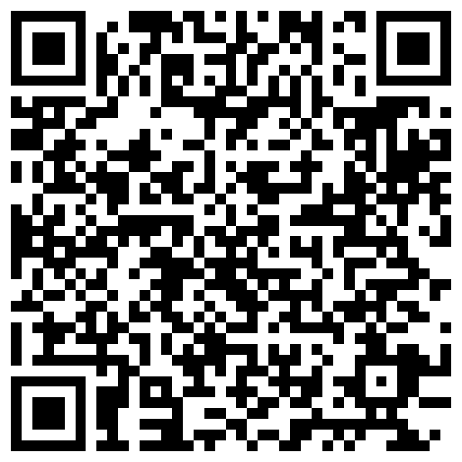
Characterizing uncertainty in lexically triggered inferences
Aaron Steven White
University of Rochester
General Linguistics Seminar
University of Oxford
13 October 2025

Slide 2
Big Question
What kinds of things do we know when we know the meaning (broadly construed) of a linguistic expression?

Slide 3
One Kind of Knowledge
How the expression can move a conversation forward when used in a particular way.

Slide 4
Leo ran the race.
Shared picture of the world
Stalnaker 1974

Slide 5
Did Leo run the race?
Leo ran the race.
Leo didn’t run the race.
?
?
Shared picture of the world

Slide 6
One Kind of Knowledge
How the expression can move a conversation forward when used in a particular way.
Another Kind of Knowledge
How the conversation has to look for it to even make sense to use the expression.

Slide 7


Leo ran the race.
Shared picture of the world
Stalnaker 1974

Slide 8
Did Leo run the race?
Leo ran the race.
Leo didn’t run the race.
?
?
Shared picture of the world
Stalnaker 1974

Slide 9
Surprising Fact
Sometimes we don’t seem to know whether particular expressions make sense in a certain kinds of conversation.

Slide 10
Leo won the race.
Participation is a precondition of winning
If Leo won he must have participated
Leo ran in the race.

Slide 11
Did Leo win the race?
Did he even run in it?
Projective
inference
?
Leo ran in the race.

Slide 12
Surprising Fact
Sometimes we don’t seem to know whether particular expressions make sense in certain kinds of conversations.
Question
What is this uncertainty uncertainty about?

Slide 13
Possibility #1
It’s sort of like lexical ambiguity.

Slide 14
Leo ran the race.
Leo ran in the race.

Slide 15
Stride quickly
Direct activity
Uncertainty must be resolved on particular occasions of use to determine speech act’s content.
Leo ran the race.
?
Leo ran in the race.

Slide 16
Possibility #1
It’s sort of like lexical ambiguity.
Possibility #2
It’s sort of like vagueness.

Slide 17
Leo ran a marathon in 3:40.
?
Leo’s marathon was fast.

Slide 18
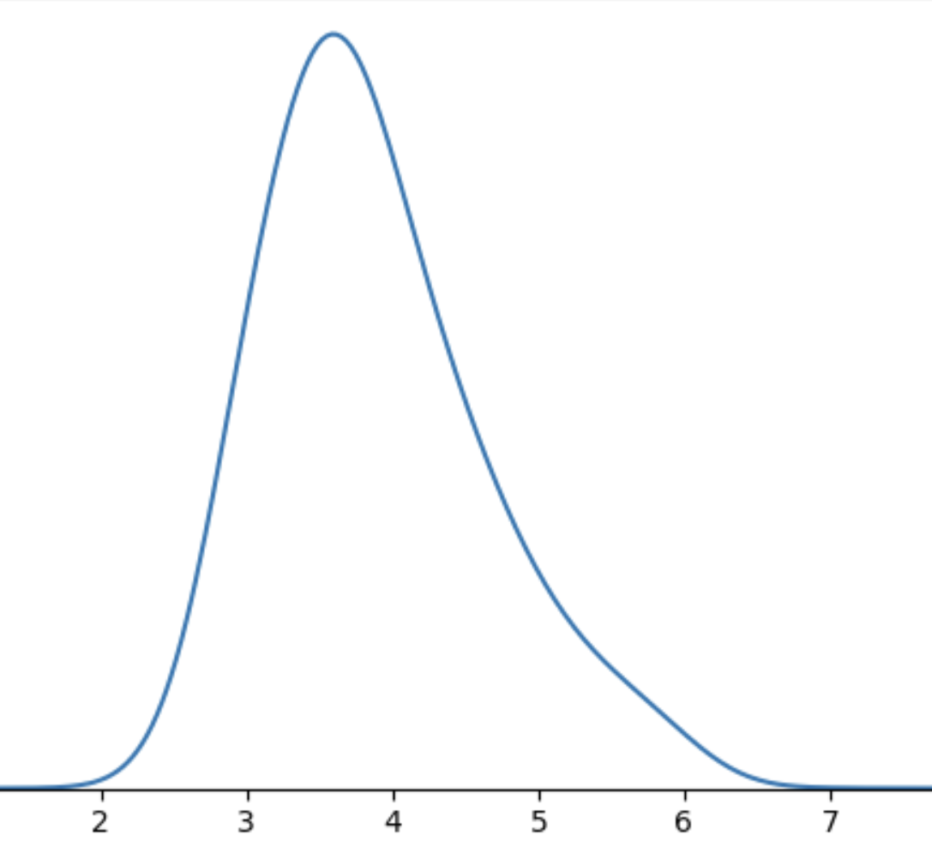
Uncertainty generally remains unresolved on particular occasions of use but speech act nonetheless has clear content.
Leo’s marathon

Slide 19
Possibility #1
Resolved Uncertainty
Uncertainty about an expression and/or context of use that tends to be resolved on particular occasions of use.
It’s sort of like lexical ambiguity.
Unresolved Uncertainty
Possibility #2
It’s sort of like vagueness.
Uncertainty about an expression and/or context of use that is manifest on all occasions of use.

Slide 20
Semantic + Contextual
Purely Contextual
Ambiguity
Resolved Uncertainty
Uncertainty across multiple distinct semantic values for an expression that have different preconditions of use.
Uncertainty across possible discrete states of a discourse that is resolved as a matter of integrating an utterance.
Uncertainty about the preconditions of use inherent to a single semantic value for an expression evoked on every use.
Vagueness
Unresolved Uncertainty

Slide 21
Question Under Discussion
Did Leo win the race?
POS answer
NEG answer
Did Leo win the race?
Leo won the race.
Leo lost the race.
Leo ran in the race.
Stalnaker 1974, Simons 2001, Abusch 2002, 2010

Slide 22
Question Under Discussion
Did he even run in it?
POS answer
NEG answer
Did Leo win the race?
Leo ran in the race.
?
Leo didn’t run in the race.
Leo ran in the race.
Simons et al. 2010

Slide 23
Semantic + Contextual
Purely Contextual
Ambiguity
Resolved Uncertainty
Uncertainty across multiple distinct semantic values for an expression that have different preconditions of use.
Uncertainty across possible discrete states of a discourse that is resolved as a matter of integrating an utterance.
Uncertainty about the preconditions of use inherent to a single semantic value for an expression evoked on every use.
Vagueness
Uncertainty across possible discrete states of a discourse that is not resolved as a matter of integrating an utterance.
Unresolved Uncertainty

Slide 24
Ideal
If we can get a purely contextual approach to work we should prefer it on parsimony grounds (all else equal).
Reason
If we can reduce some kind of knowledge to general communicative principles, we should.

Slide 25
This Talk
Expressions carry information about preconditions of use in their conventional meanings.
Open class items are (at least part of) the locus of this information.

Slide 26
Case Study Karttunen 1971 et seq.
Uncertainty about factive inferences.

Slide 27
Clause-embedding predicate
Embedded clause
Does Stacy love that Leo lost the race?
Leo lost the race
Leo lost the race.

Slide 28
Case Study Karttunen 1971 et seq.
Uncertainty about factive inferences.
Uncertainty about factive inferences, which are a species of projective inference.

Slide 29
Clause-embedding predicate
Embedded clause
Does Stacy love that Leo lost the race?
Leo lost the race
Leo lost the race.

Slide 30
Case Study Karttunen 1971 et seq.
Uncertainty about factive inferences, which are a species of projective inference.
Reason
Class of predicates that could give rise to factive inferences–clause-embedding predicates–is large, so we can measure high-level trends across many predicates.

Slide 31
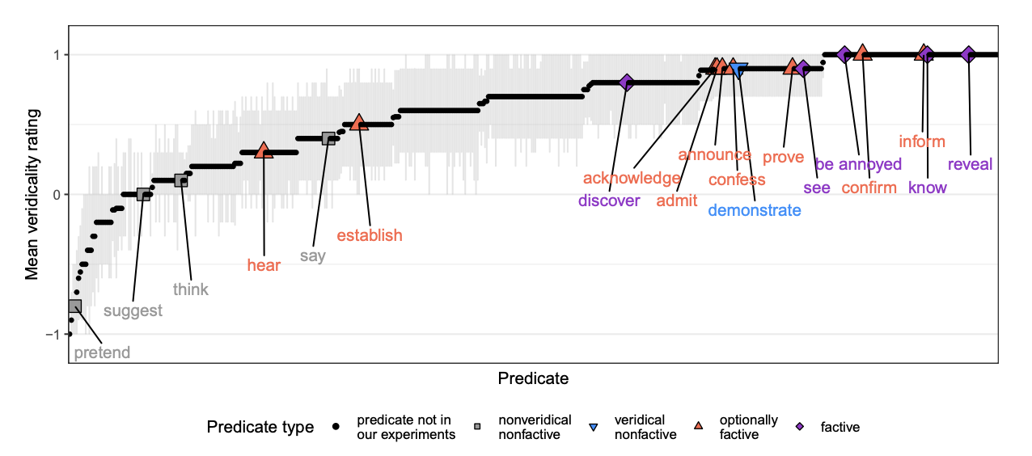
Factive
White & Rawlins 2018, White et al. 2018, Degen and Tonhauser 2022

Slide 32
Part 1
Part 2
From where does evidence for uncertainty come?
Is uncertainty about factive inferences resolved or unresolved?

Slide 33
Semantic + Contextual
Purely Contextual
Ambiguity
Resolved Uncertainty
Uncertainty across multiple distinct semantic values for an expression that have different preconditions of use.
Uncertainty across possible discrete states of a discourse that is resolved as a matter of integrating an utterance.
Uncertainty about the preconditions of use inherent to a single semantic value for an expression evoked on every use.
Vagueness
Uncertainty across possible discrete states of a discourse that is not resolved as a matter of integrating an utterance.
Unresolved Uncertainty

Slide 34
Part 1
Part 2
From where does evidence for uncertainty come?
Is uncertainty about factive inferences resolved or unresolved?
Part 3
Are factive inferences semantically encoded?

Slide 35
Semantic + Contextual
Purely Contextual
Ambiguity
Resolved Uncertainty
Uncertainty across multiple distinct semantic values for an expression that have different preconditions of use.
Uncertainty across possible discrete states of a discourse that is resolved as a matter of integrating an utterance.
Uncertainty about the preconditions of use inherent to a single semantic value for an expression evoked on every use.
Vagueness
Uncertainty across possible discrete states of a discourse that is not resolved as a matter of integrating an utterance.
Unresolved Uncertainty

Slide 36
Part 1
Part 2
From where does evidence for uncertainty come?
Is uncertainty about factive inferences resolved or unresolved?
Part 4
Part 3
Implications for semantic theory.
Are factive inferences semantically encoded?

Slide 37
Uncertainty about Factivity

Slide 38
Question
Where does evidence for uncertainty in factive inferences come from?
Answer
Aggregate measures derived from inference judgment tasks aimed at capturing projective inferences.

Slide 39
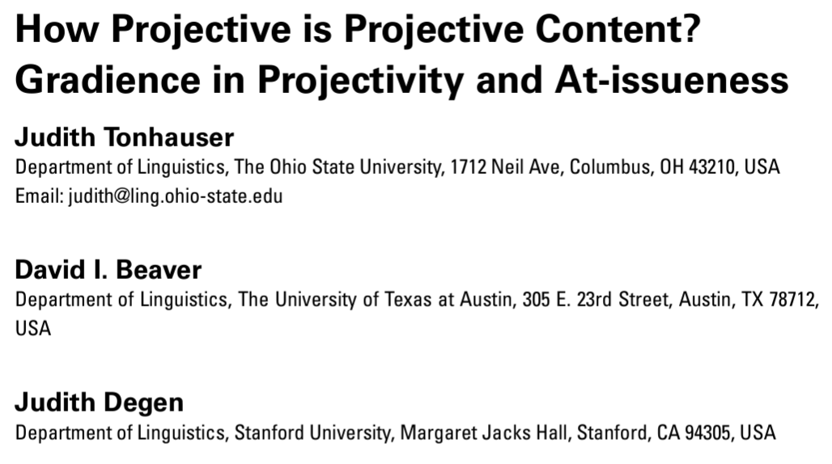
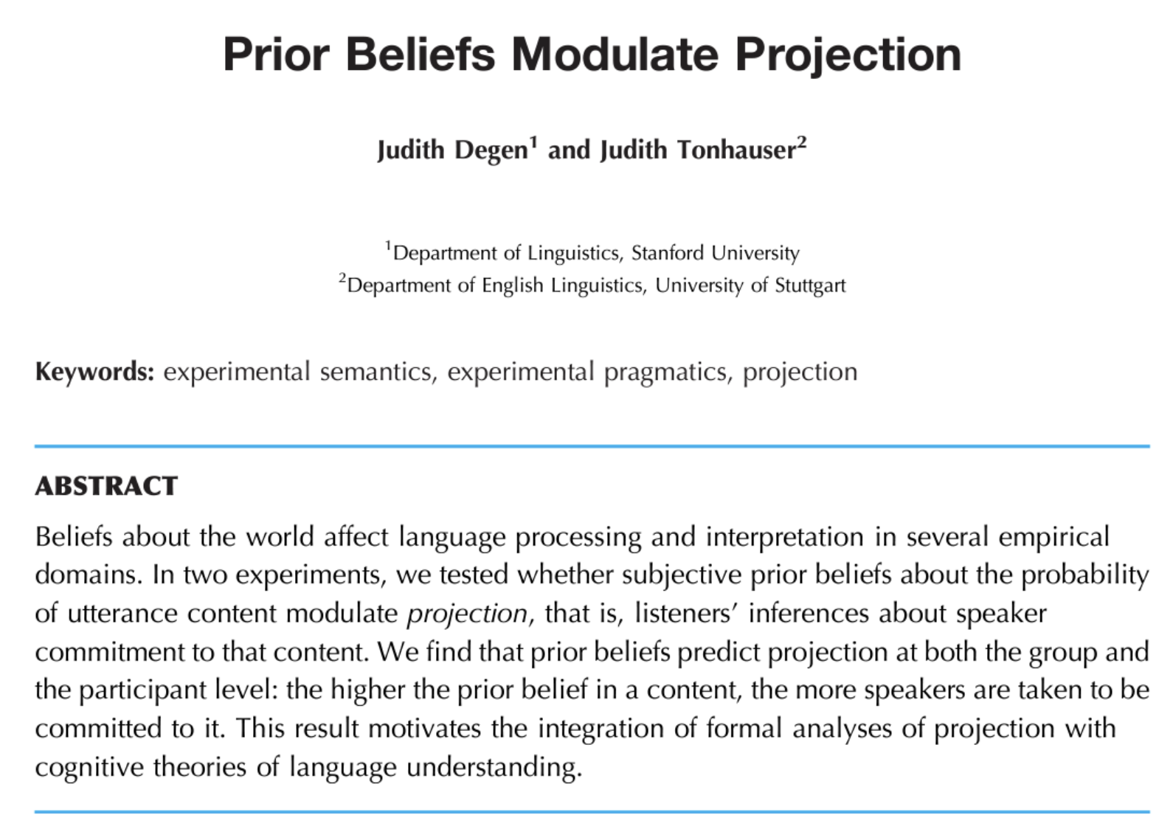
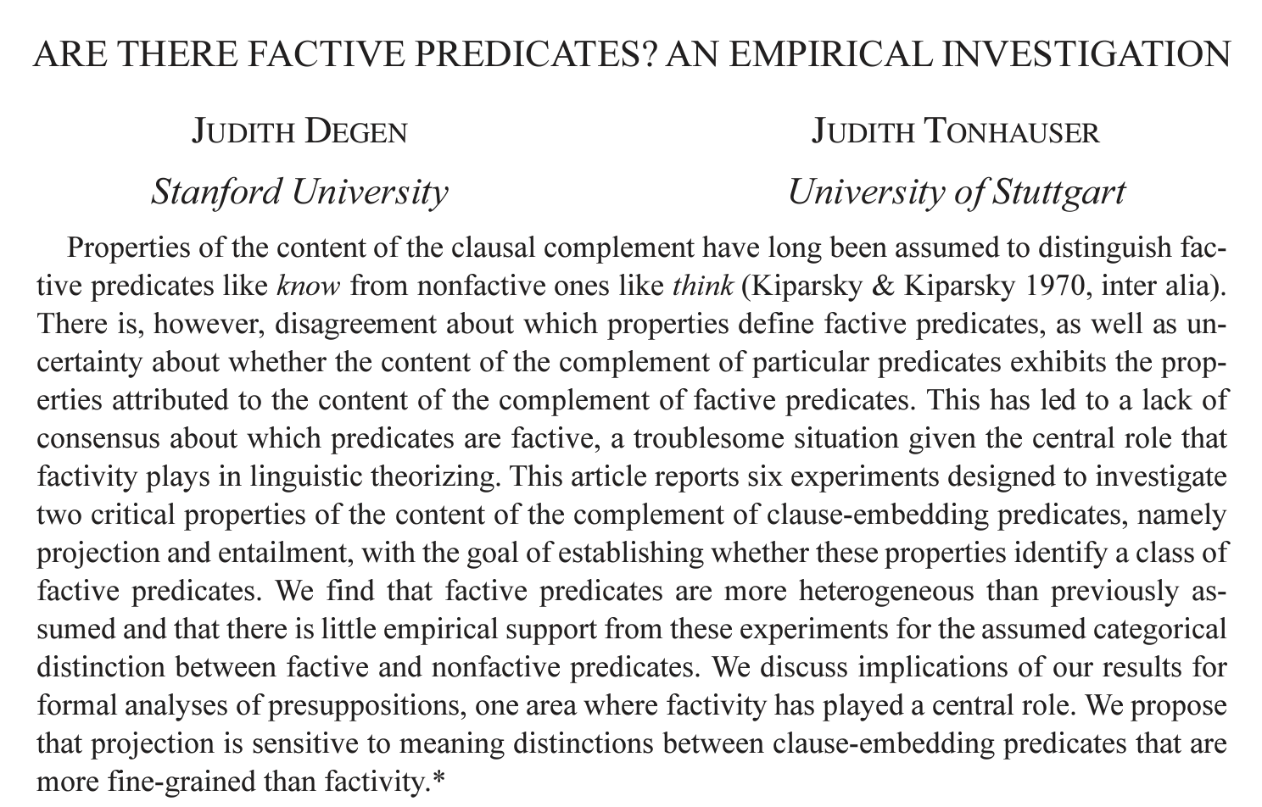

Slide 40
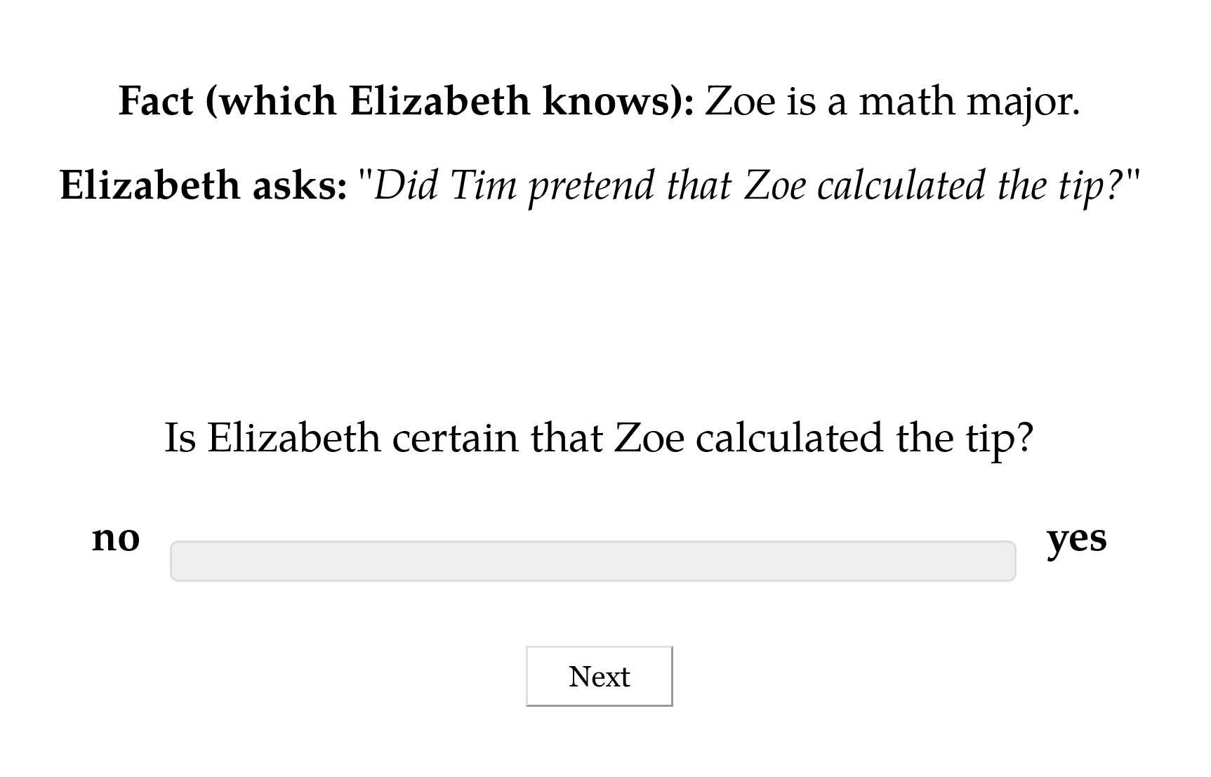

Slide 43
Norming Dataset
Measure prior knowledge: rate likelihood of proposition P given fact F.

Slide 44
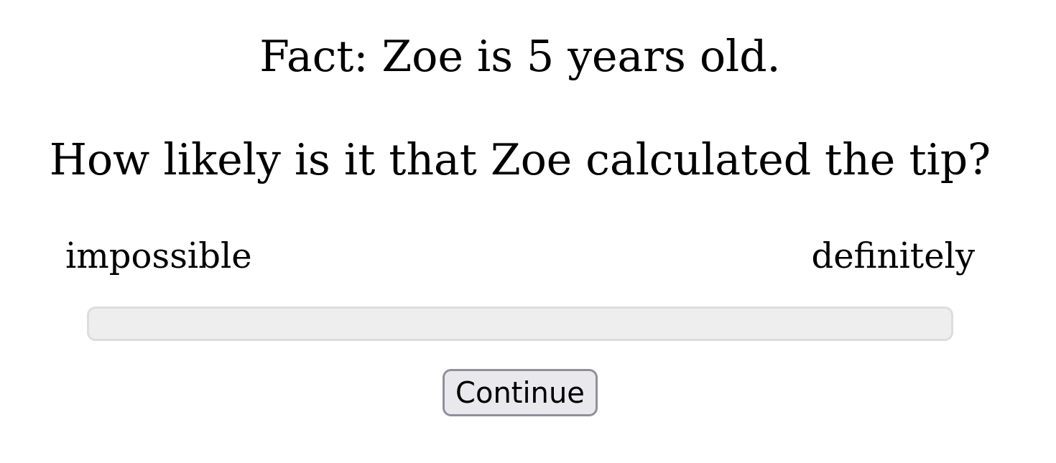

Slide 45
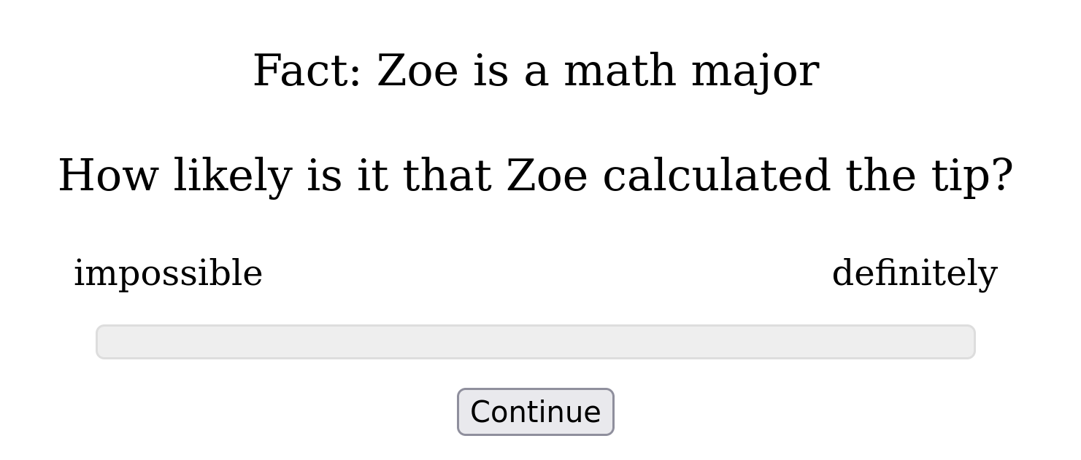

Slide 46
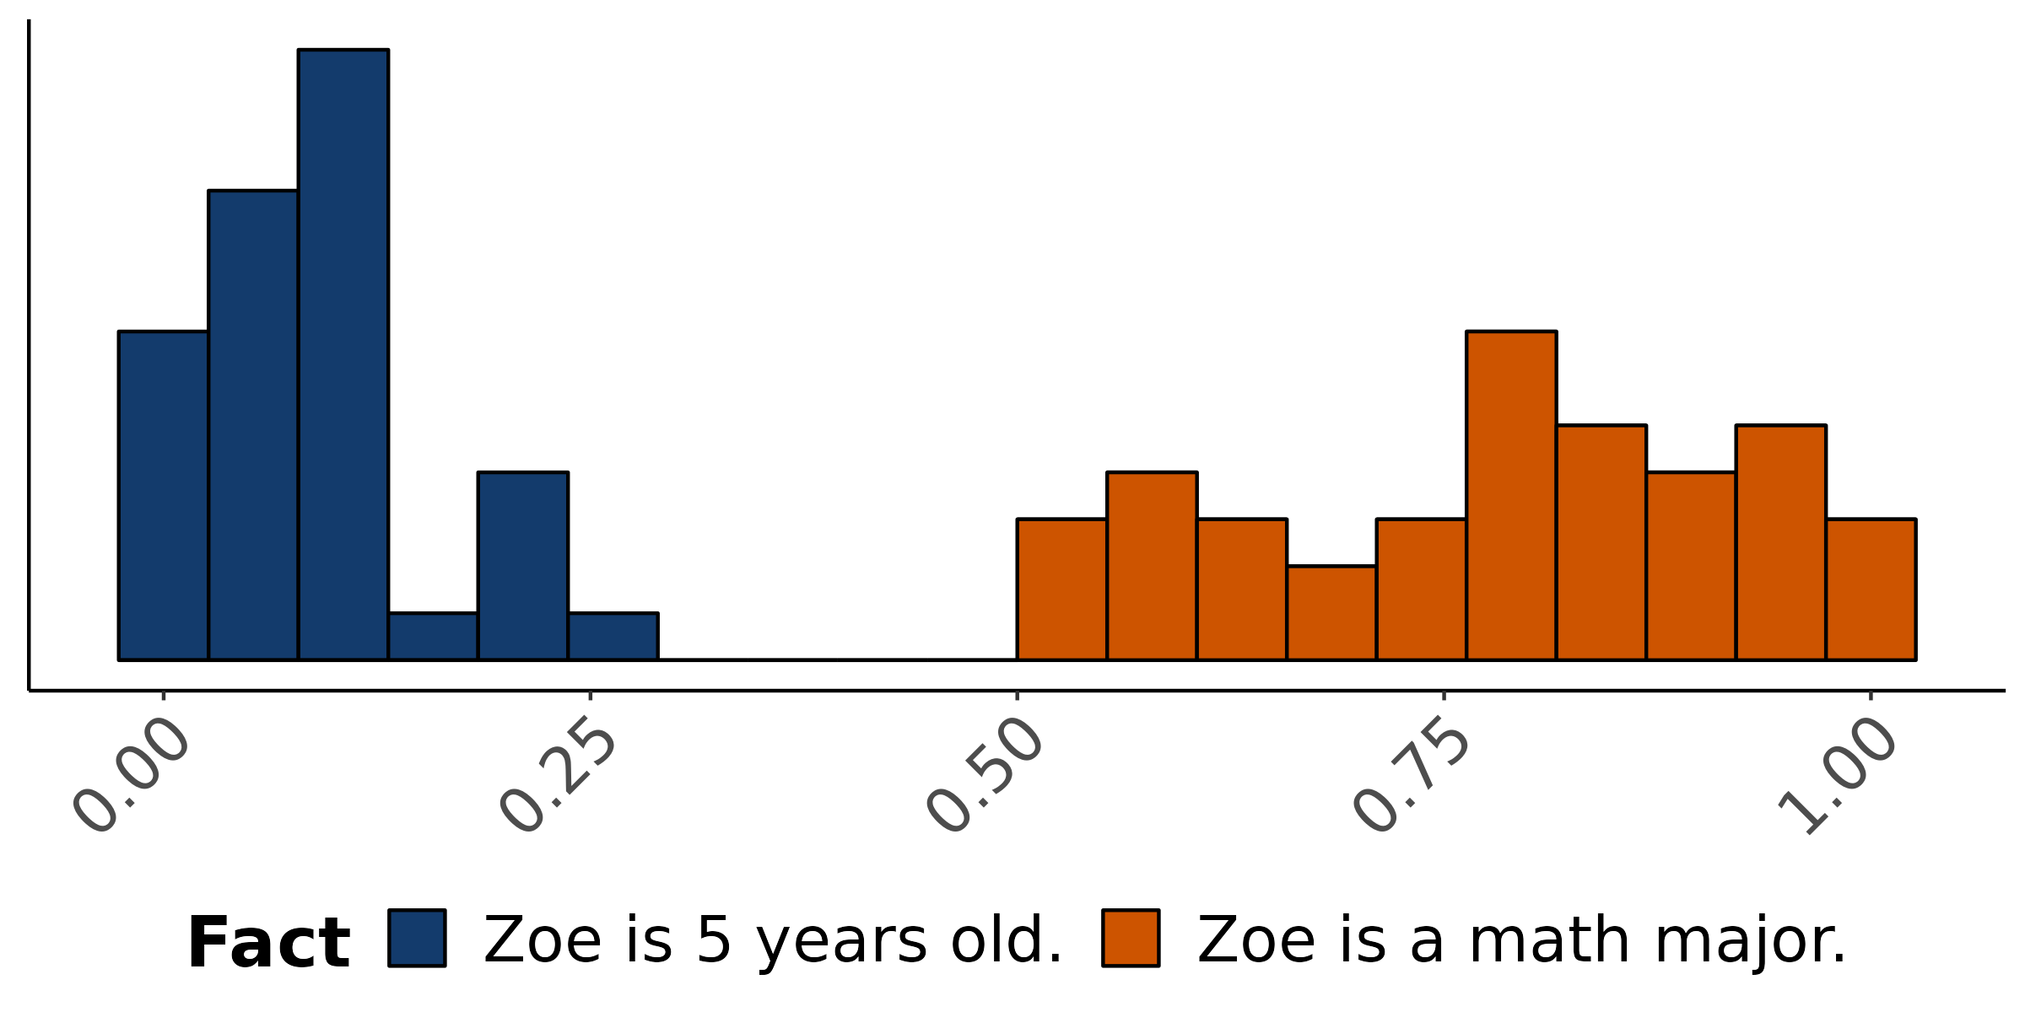
Empirical distribution of norming response
How likely is is that Zoe calculated the tip?

Slide 47
Norming Dataset
Measure prior knowledge: rate likelihood of proposition P given fact F.
Projection Dataset
Measure veridicality inferences: rate X’s certainty that P given F and a context where X asks Did/Does Y V that P?

Slide 48
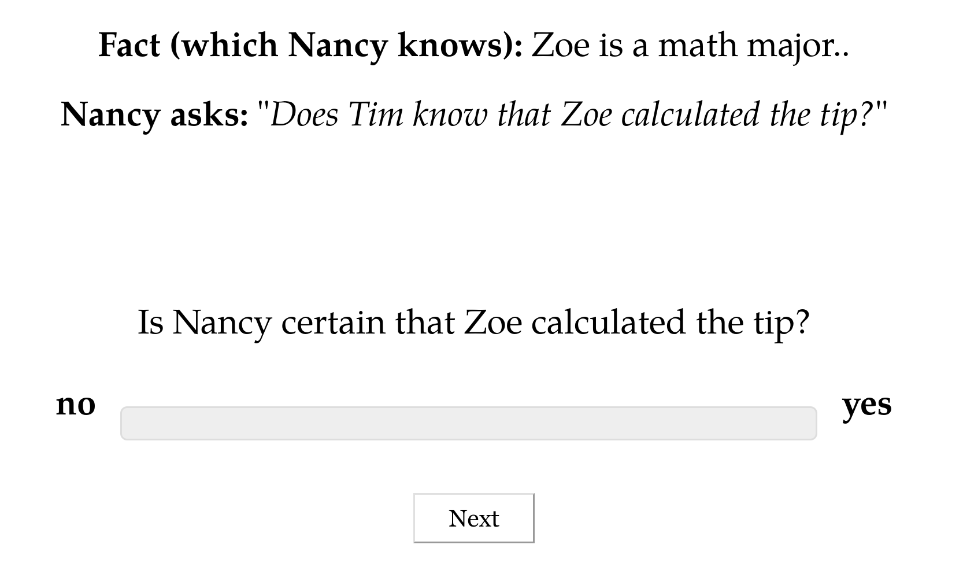

Slide 49
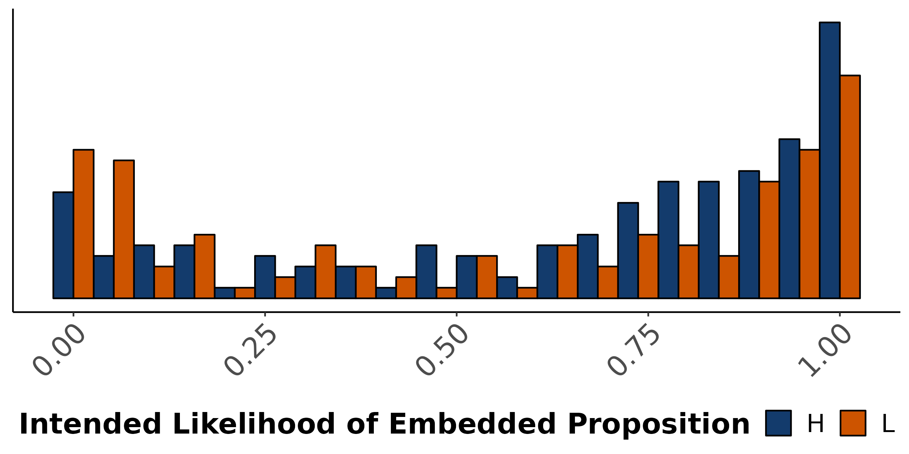
Empirical distribution of projection response
X asks: Does Y know that P?
Is X certain that P?

Slide 51
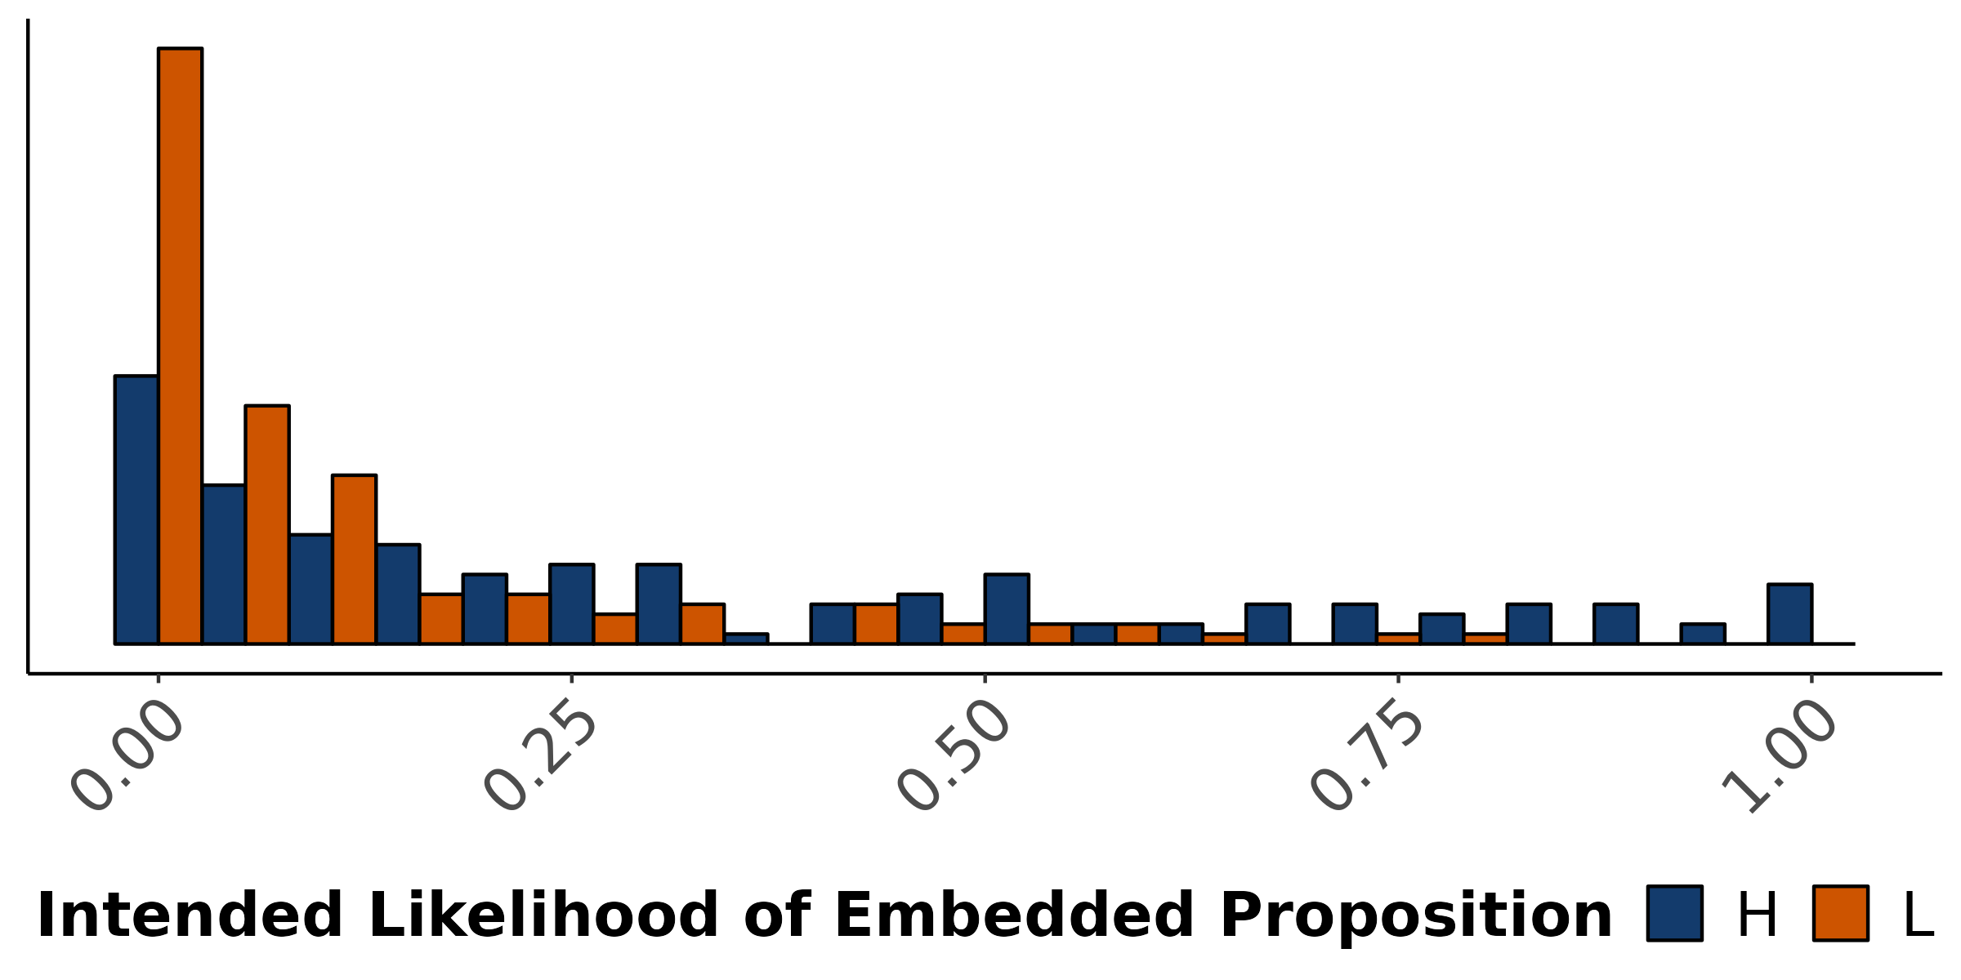
Empirical distribution of projection response
X asks: Did Y pretend that P?
Is X certain that P?

Slide 52
Resolving Uncertainty

Slide 53
Question
What do the two hypotheses about uncertainty (non)resolution predict about the distribution of judgments?

Slide 54
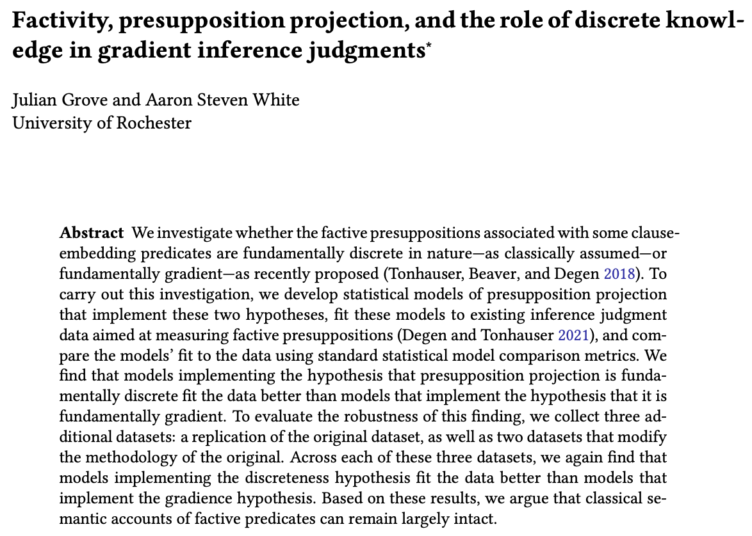
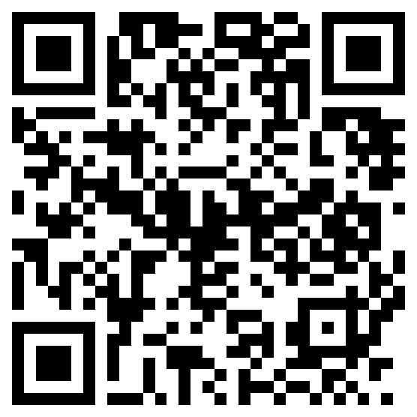
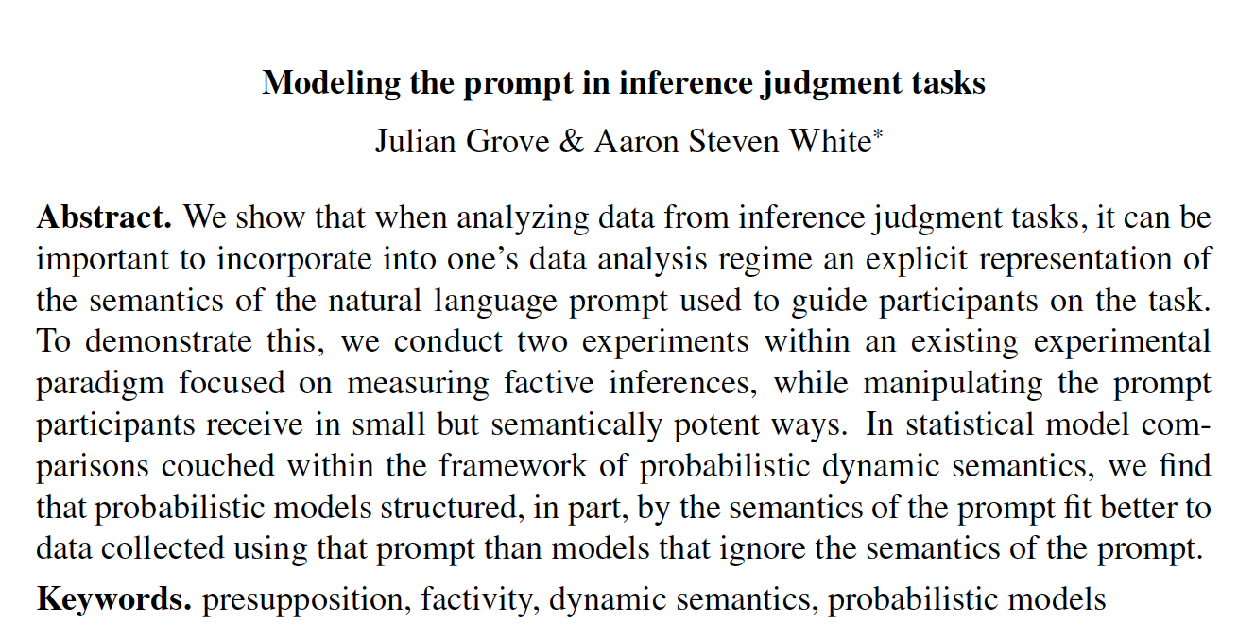
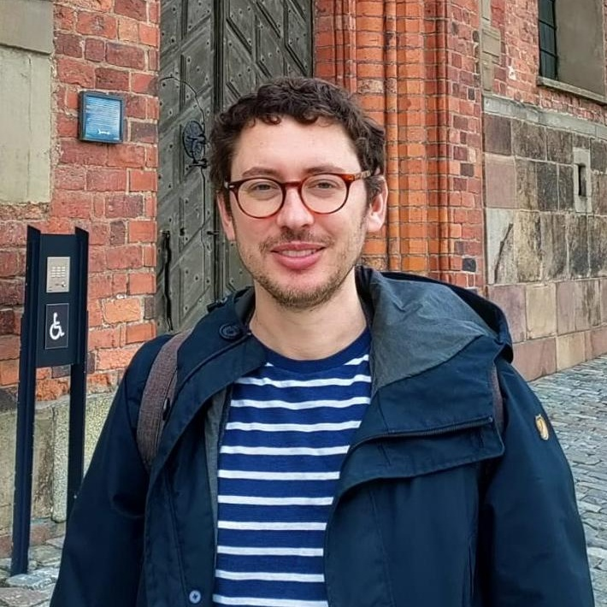
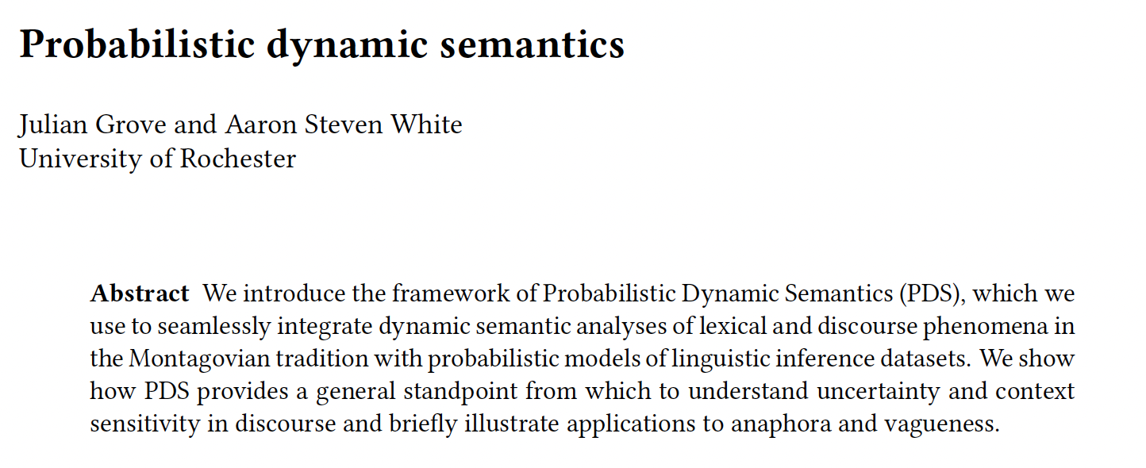
Accepted at Natural Language Semantics
In Proceedings of Experiments in Linguistic Meaning 3
Under review at Cambridge Elements in Semantics
Julian Grove
University of Florida

Slide 55
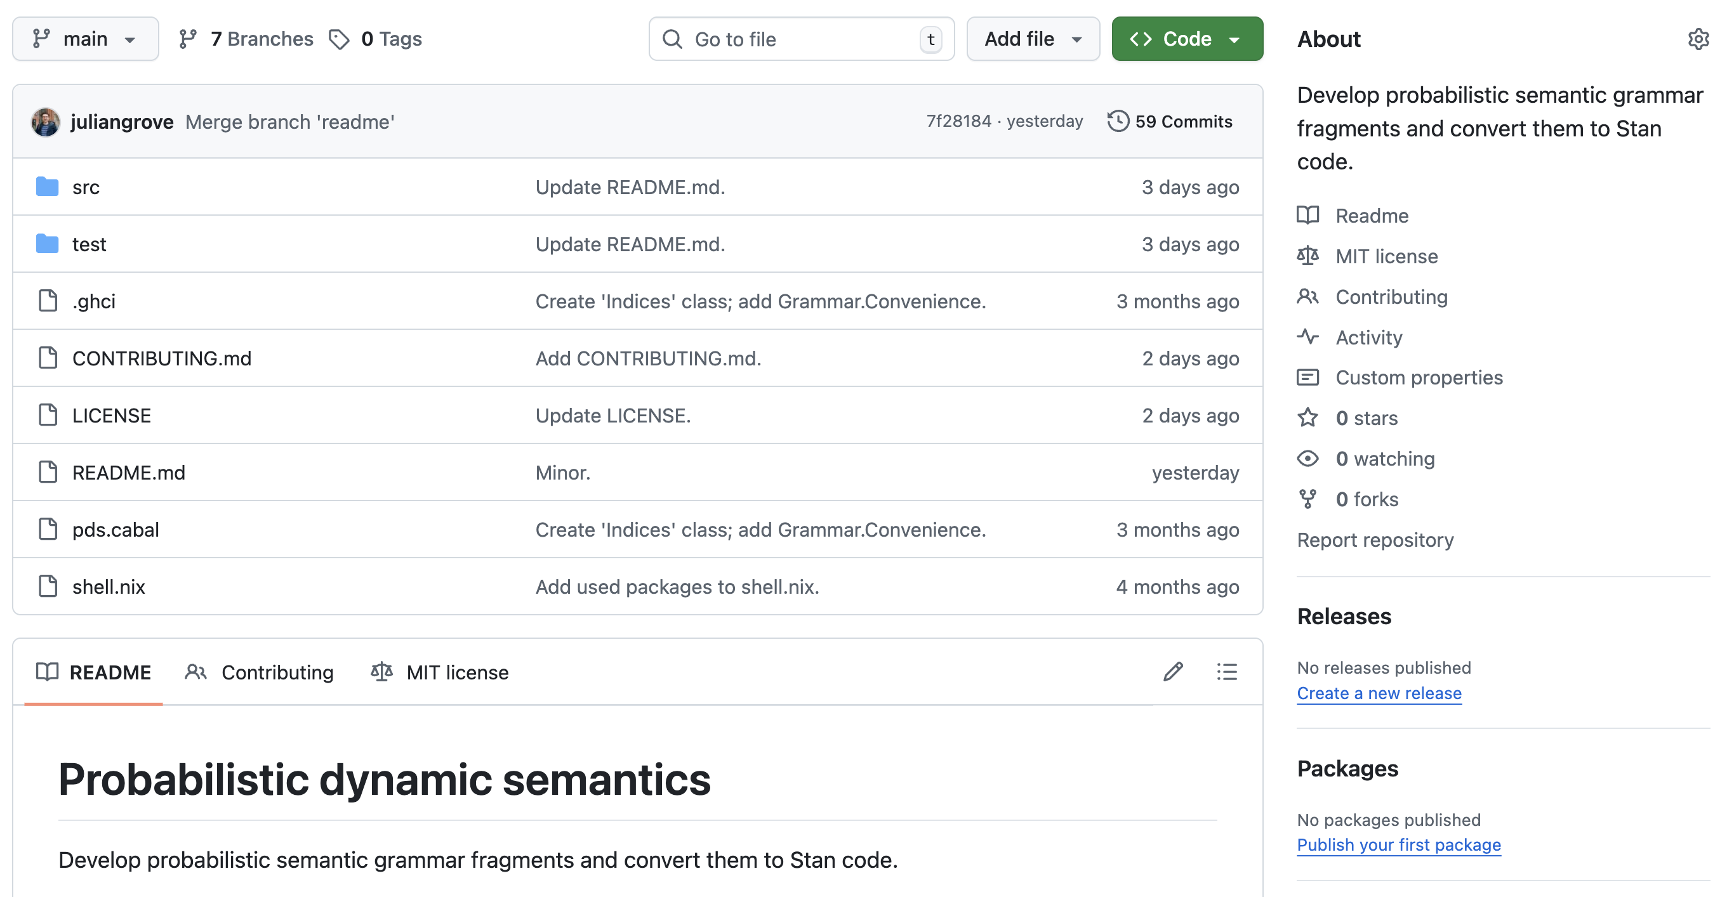
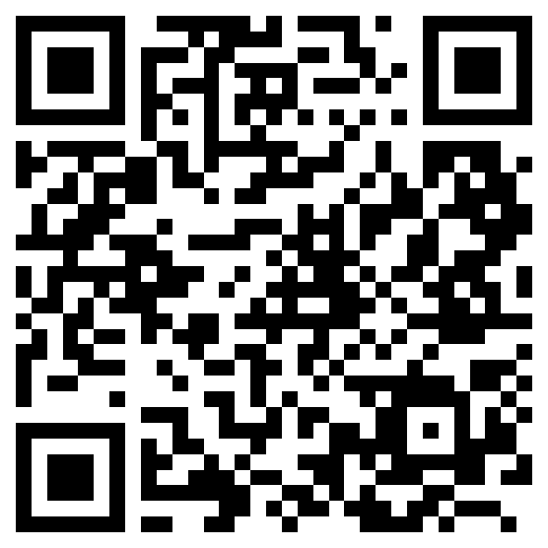
github.com/probabilistic-dynamic-semantics/pds

Slide 56
Nonresolution hypothesis
Judgments follow a single distribution whose expected value is determined by the predicate + embedded content.

Slide 57
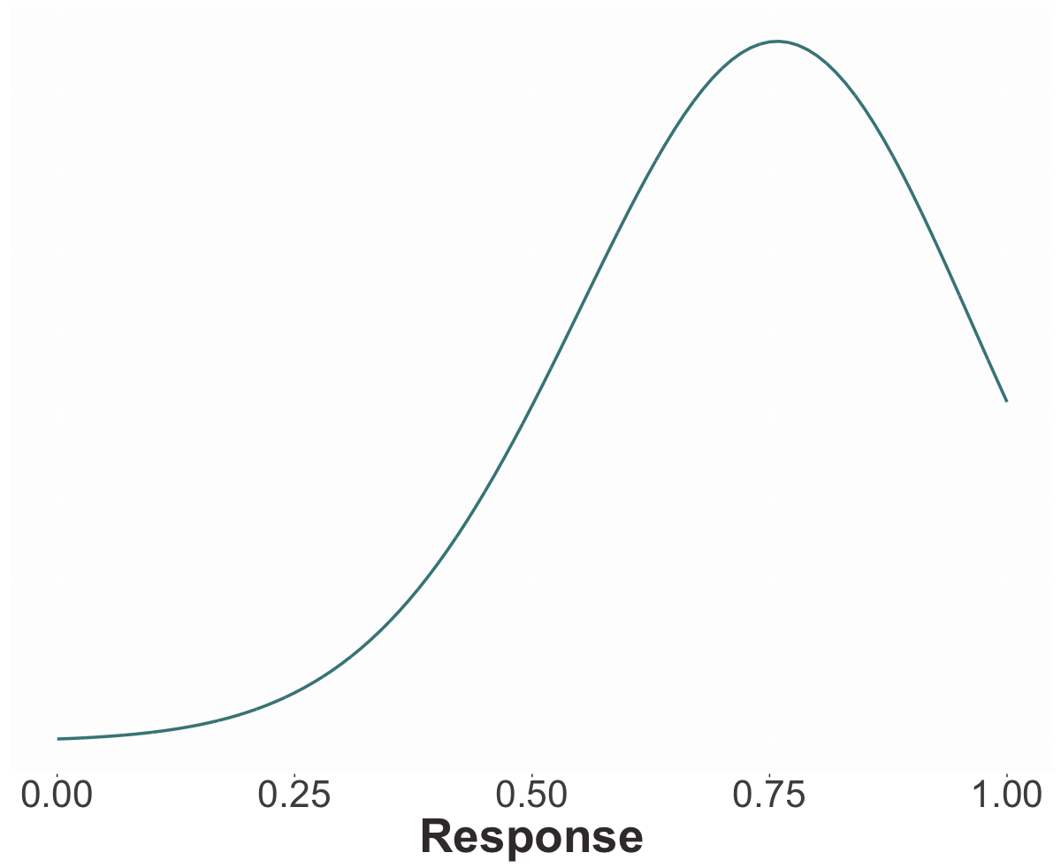
Showing truncated normal distribution but same results with ordered beta distributions!

Slide 58
Nonresolution hypothesis
Judgments follow a single distribution whose expected value is determined by the predicate + embedded content.
Resolution hypothesis
Judgments follow a mixture of three distributions: the FALSE and TRUE distributions, determined by the predicate, and the PRIOR distribution, determined by EC.

Slide 59
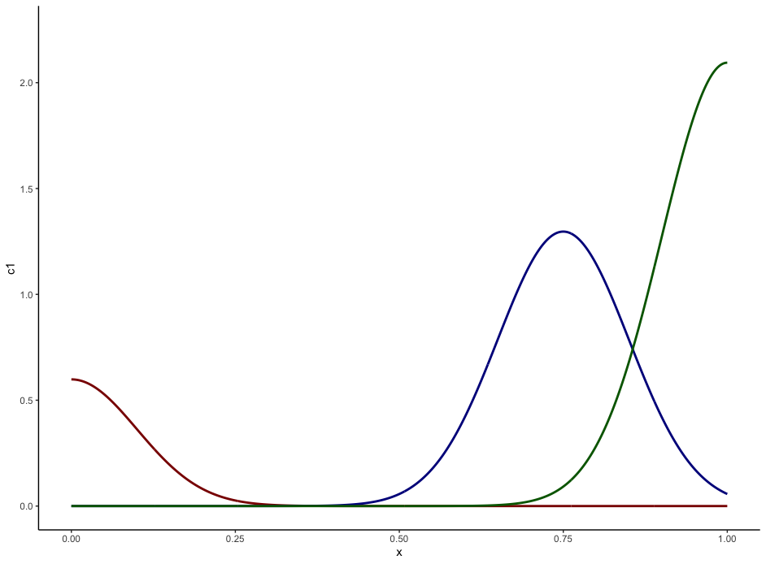
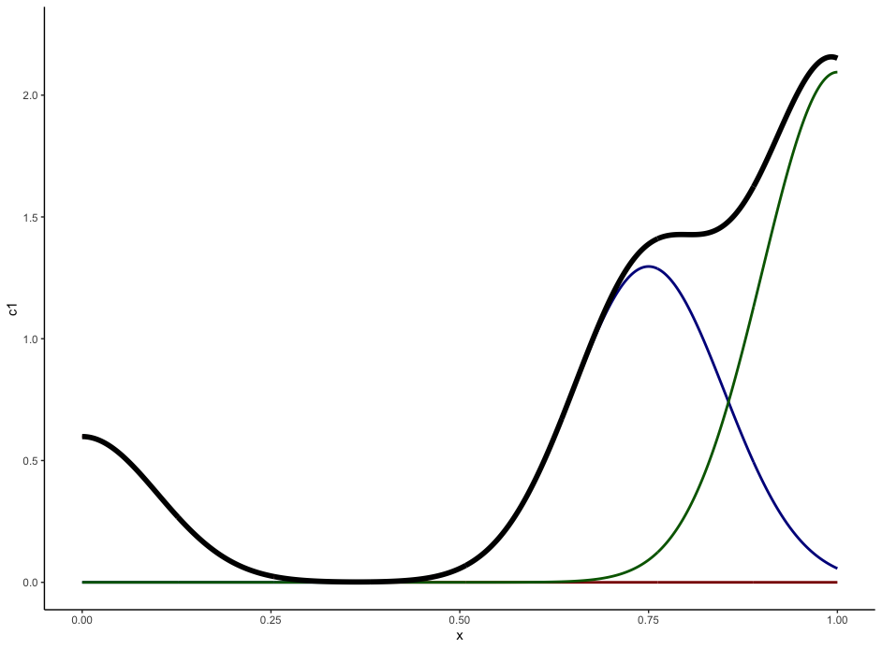
TRUE
PRIOR
FALSE

Slide 60
Method
Fit models to D&T’s norming data using MCMC and compare fits.
Fit models to D&T’s projection data using MC, with priors determined by norming fits, and compare fits.

Slide 61
Question #1
Is uncertainty about prior beliefs resolved or unresolved?

Slide 62
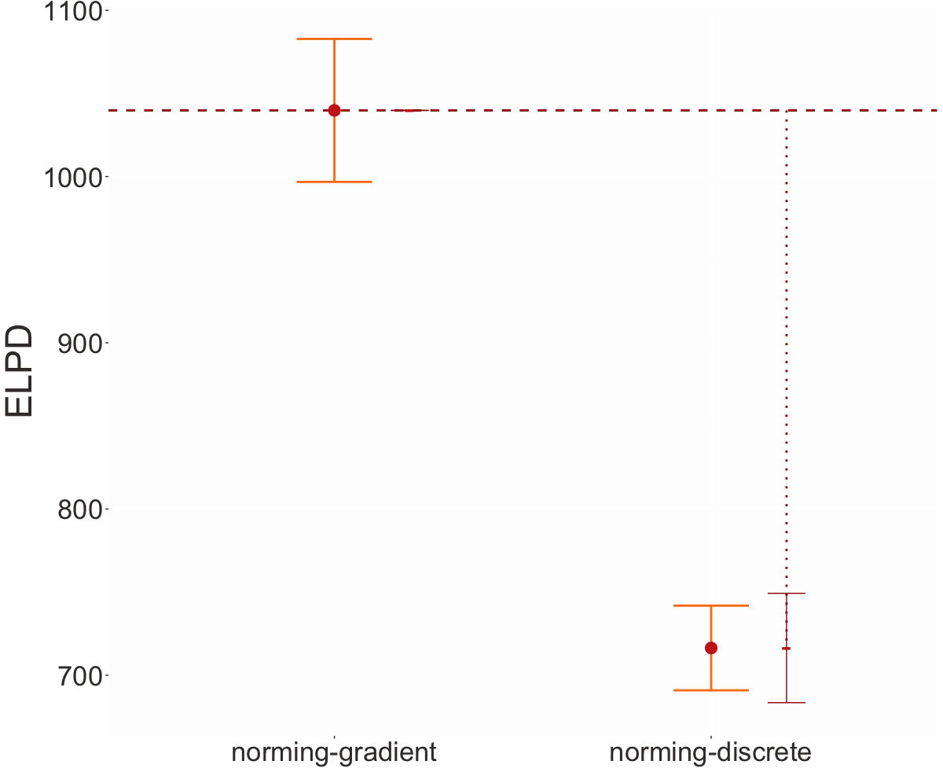
Higher means better fit
Uncertainty about prior beliefs is unresolved.
Unresolved
Resolved

Slide 63
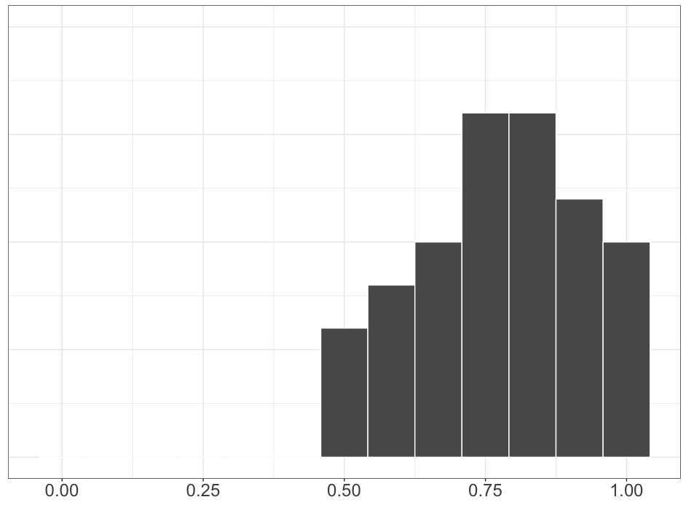
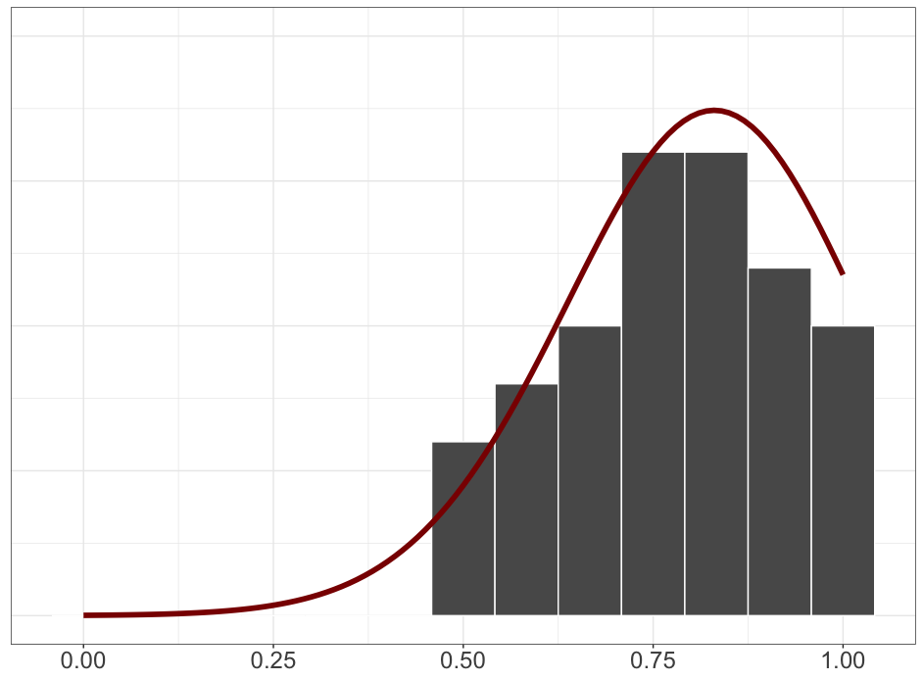
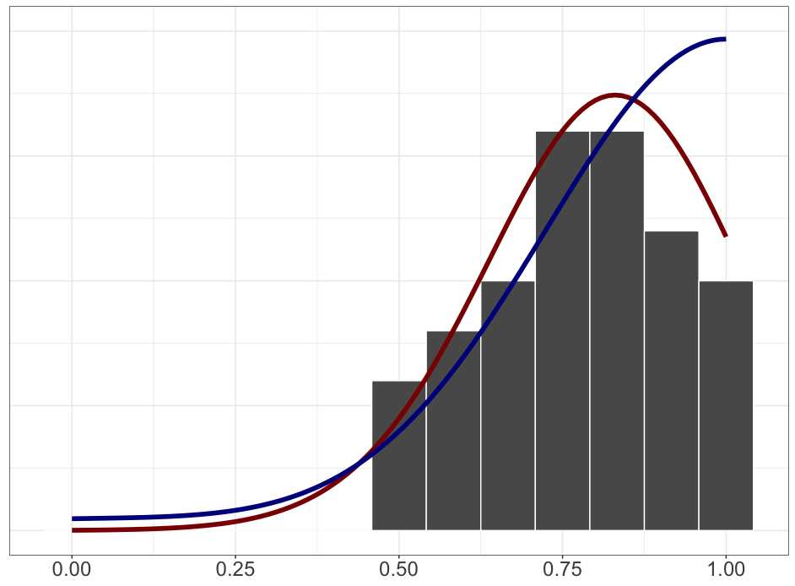

Slide 64
Question #1
Is uncertainty about prior beliefs resolved or unresolved?
Question #2
Is uncertainty about factive inferences resolved or unresolved?

Slide 65
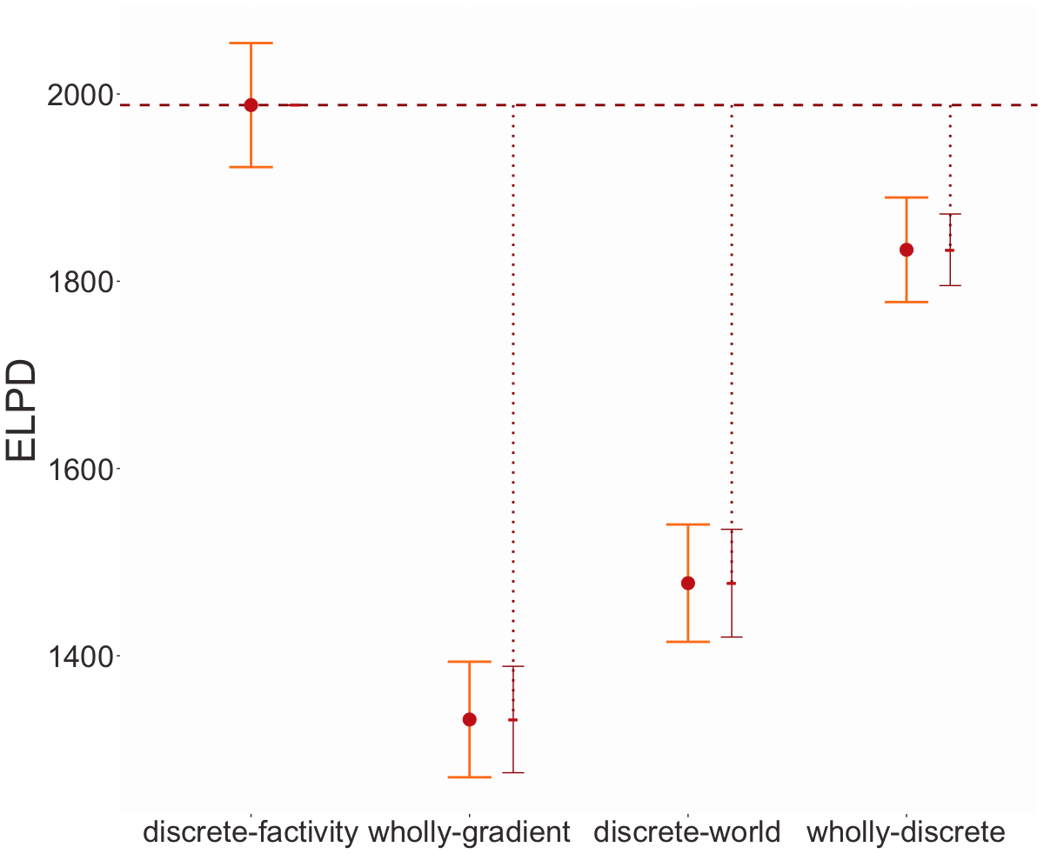
Uncertainty about factive inferences is resolved.
Factivity
Resolved
Factivity
Unresolved
Factivity
Unresolved
Factivity
Resolved

Slide 66
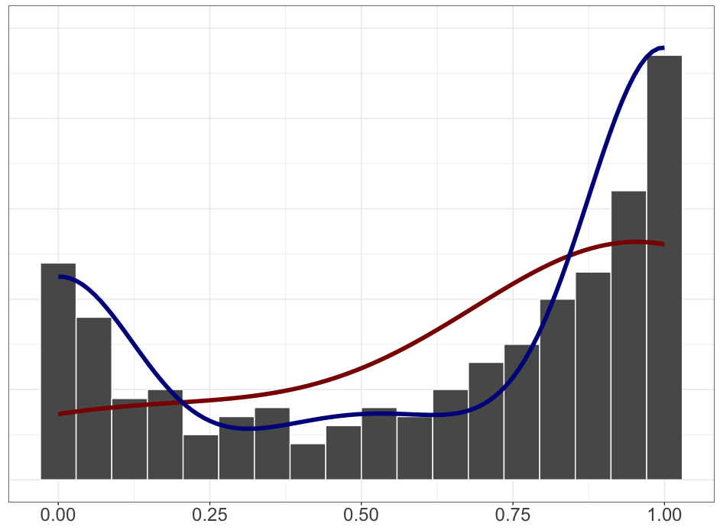
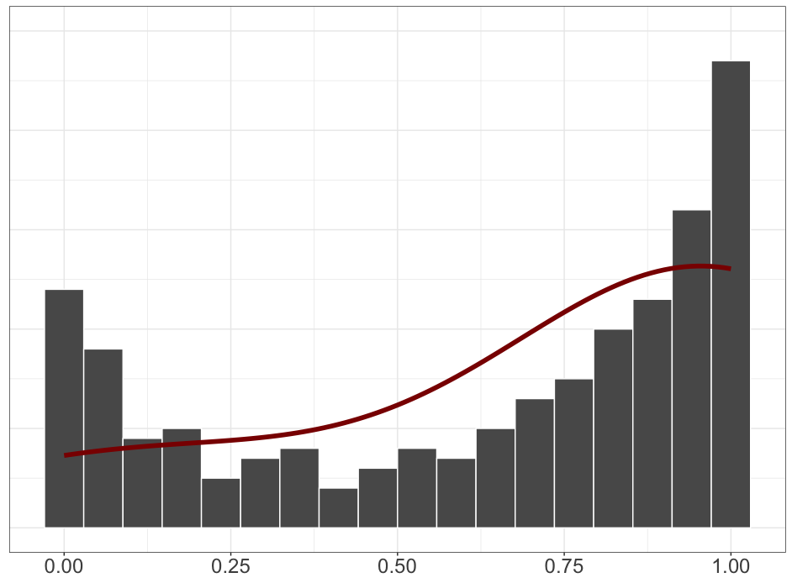
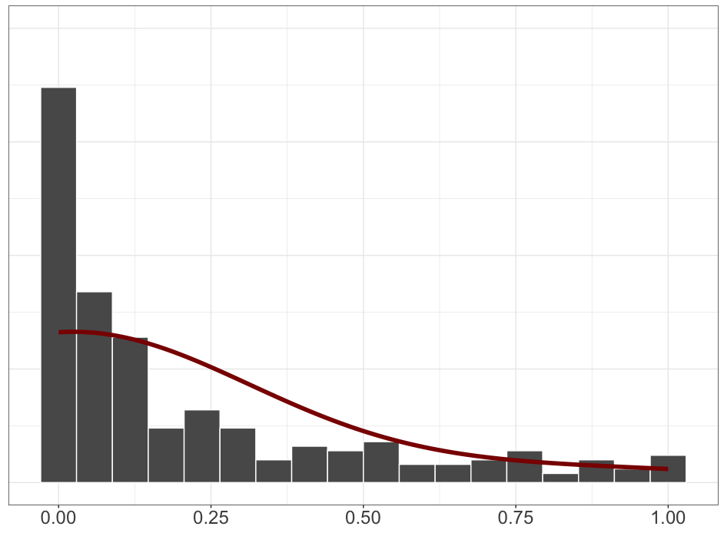
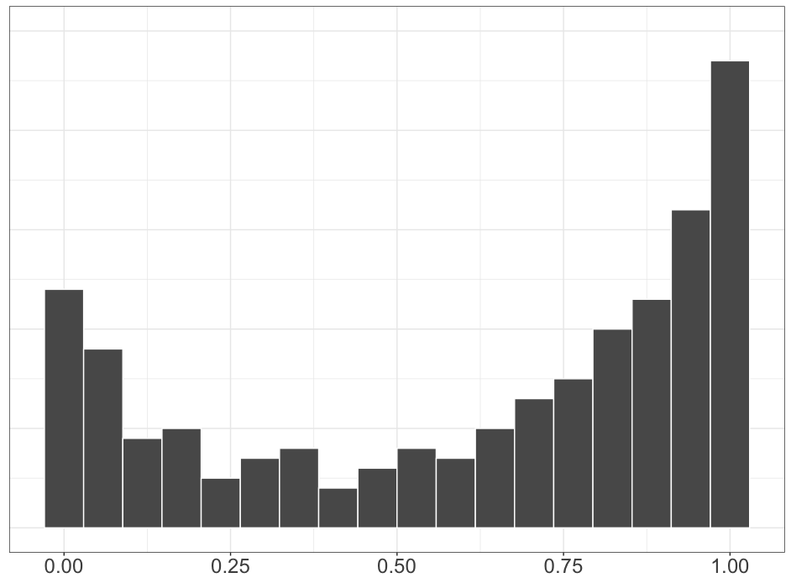
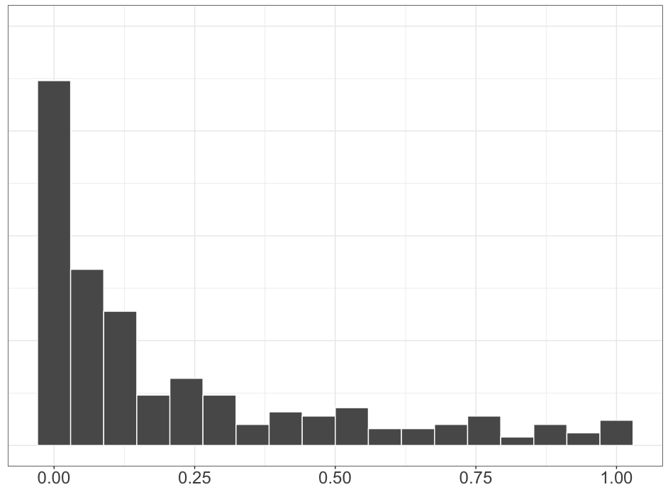
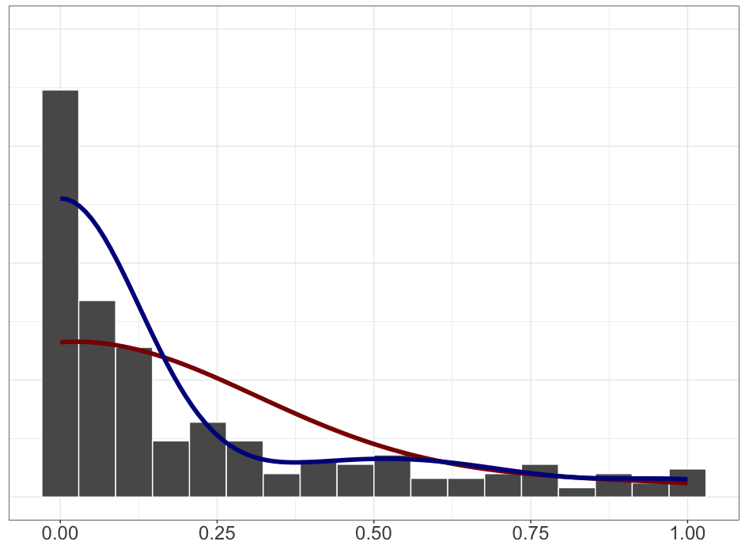
know
pretend

Slide 67
Question #3 see Appendix B
Does the prompt encourage participants to “respond more discretely” because the prompt is a polar question?

Slide 69
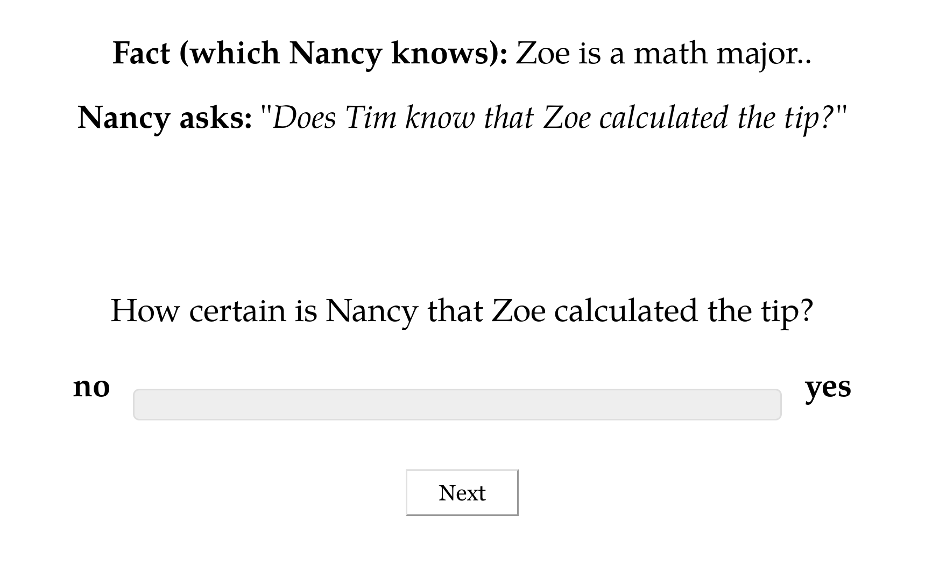

Slide 70
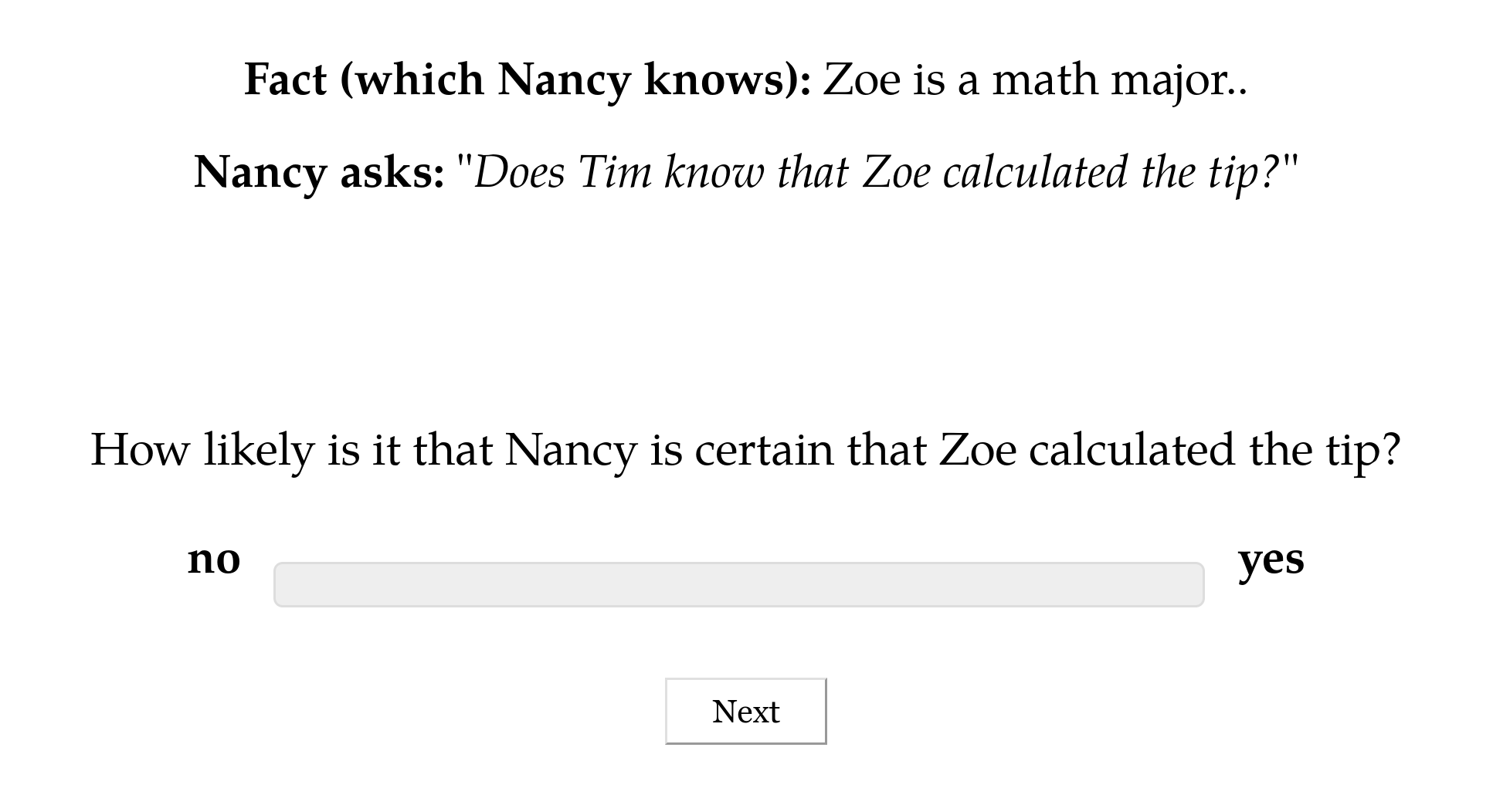

Slide 71
Question #3 see Appendix B
Does the prompt encourage participants to “respond more discretely” because the prompt is a polar question?
Question #4 see Appendix C
Do contents biased for high or low likelihood cause people to “respond more discretely”?

Slide 72
Interim Discussion

Slide 73
Question
Is uncertainty about factive inferences resolved or unresolved?
Answer
Uncertainty in factive inferences is resolved, even though uncertainty about prior beliefs is unresolved.

Slide 74
Semantic + Contextual
Purely Contextual
Ambiguity
Resolved Uncertainty
Uncertainty across multiple distinct semantic values for an expression that have different preconditions of use.
Uncertainty across possible discrete states of a discourse that is resolved as a matter of integrating an utterance.
Uncertainty about the preconditions of use inherent to a single semantic value for an expression evoked on every use.
Vagueness
Uncertainty across possible discrete states of a discourse that is not resolved as a matter of integrating an utterance.
Unresolved Uncertainty

Slide 75
Next Question
Are factive inferences driven by some semantically encoded property (or properties)?
Prediction
If there were such a property or properties, they should…
…show a trace in the inference judgment profiles and…
…that trace should be correlated with distribution.

Slide 76
Predicates don’t appear to cluster!
White & Rawlins 2018, White et al. 2018, Degen and Tonhauser 2022

Slide 77
Possibility #1
Lack of apparent clustering may be due to noise in the measurement.
Possibility #2
Lack of apparent clustering may be due to predicates that are polysemous with respect to factive and nonfactive subclasses of clause-embedding predicates.

Slide 78
It worries Leo that Thea left.
Thea left.
Leo worries that Thea left.

Slide 79
Question
If we develop a model that accounts for measurement noise and the possibility of polysemy, are factive inferences correlated with distribution?

Slide 80
Semantic Encoding

Slide 81
Approach
Induce full classification of clause-embedding lexicon from (i) inference types that clause-embedding predicates are known to vary on; and (ii) a measure of distribution.

Slide 82
Cognitive Nonfactives
Cognitive Semifactives
Positive Emotive Factives
thinks
suspects
knows
realized
likes
is happy
A believes that B happened.
A believes that B happened.
A believes that B happened.
B happened.
A believes that B happened.
A wants B to have happened.
think
suspect
know
realize
doesn’t like
isn’t happy
A doesn’t believes that B happened.
A doesn’t believes that B happened.
A doesn’t believes that B happened.

Slide 83
Approach
Induce full classification of clause-embedding lexicon from (i) inference types that clause-embedding predicates are known to vary on; and (ii) a measure of distribution.
Ensures induced classes are cohesive with respect to both inference and distribution and thus plausibly semantic!

Slide 84
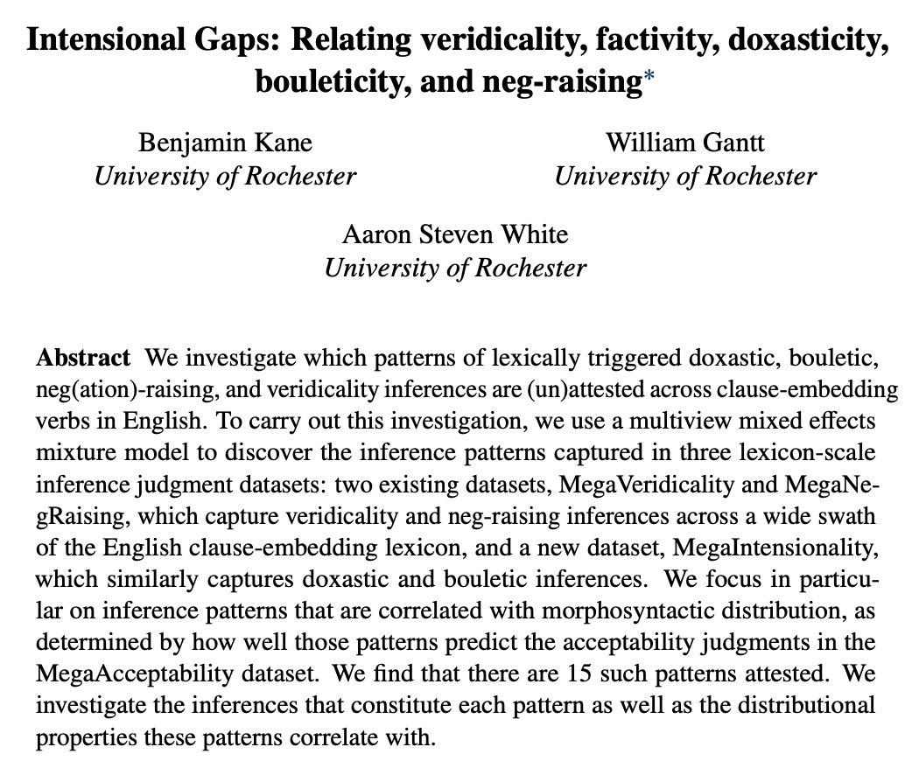
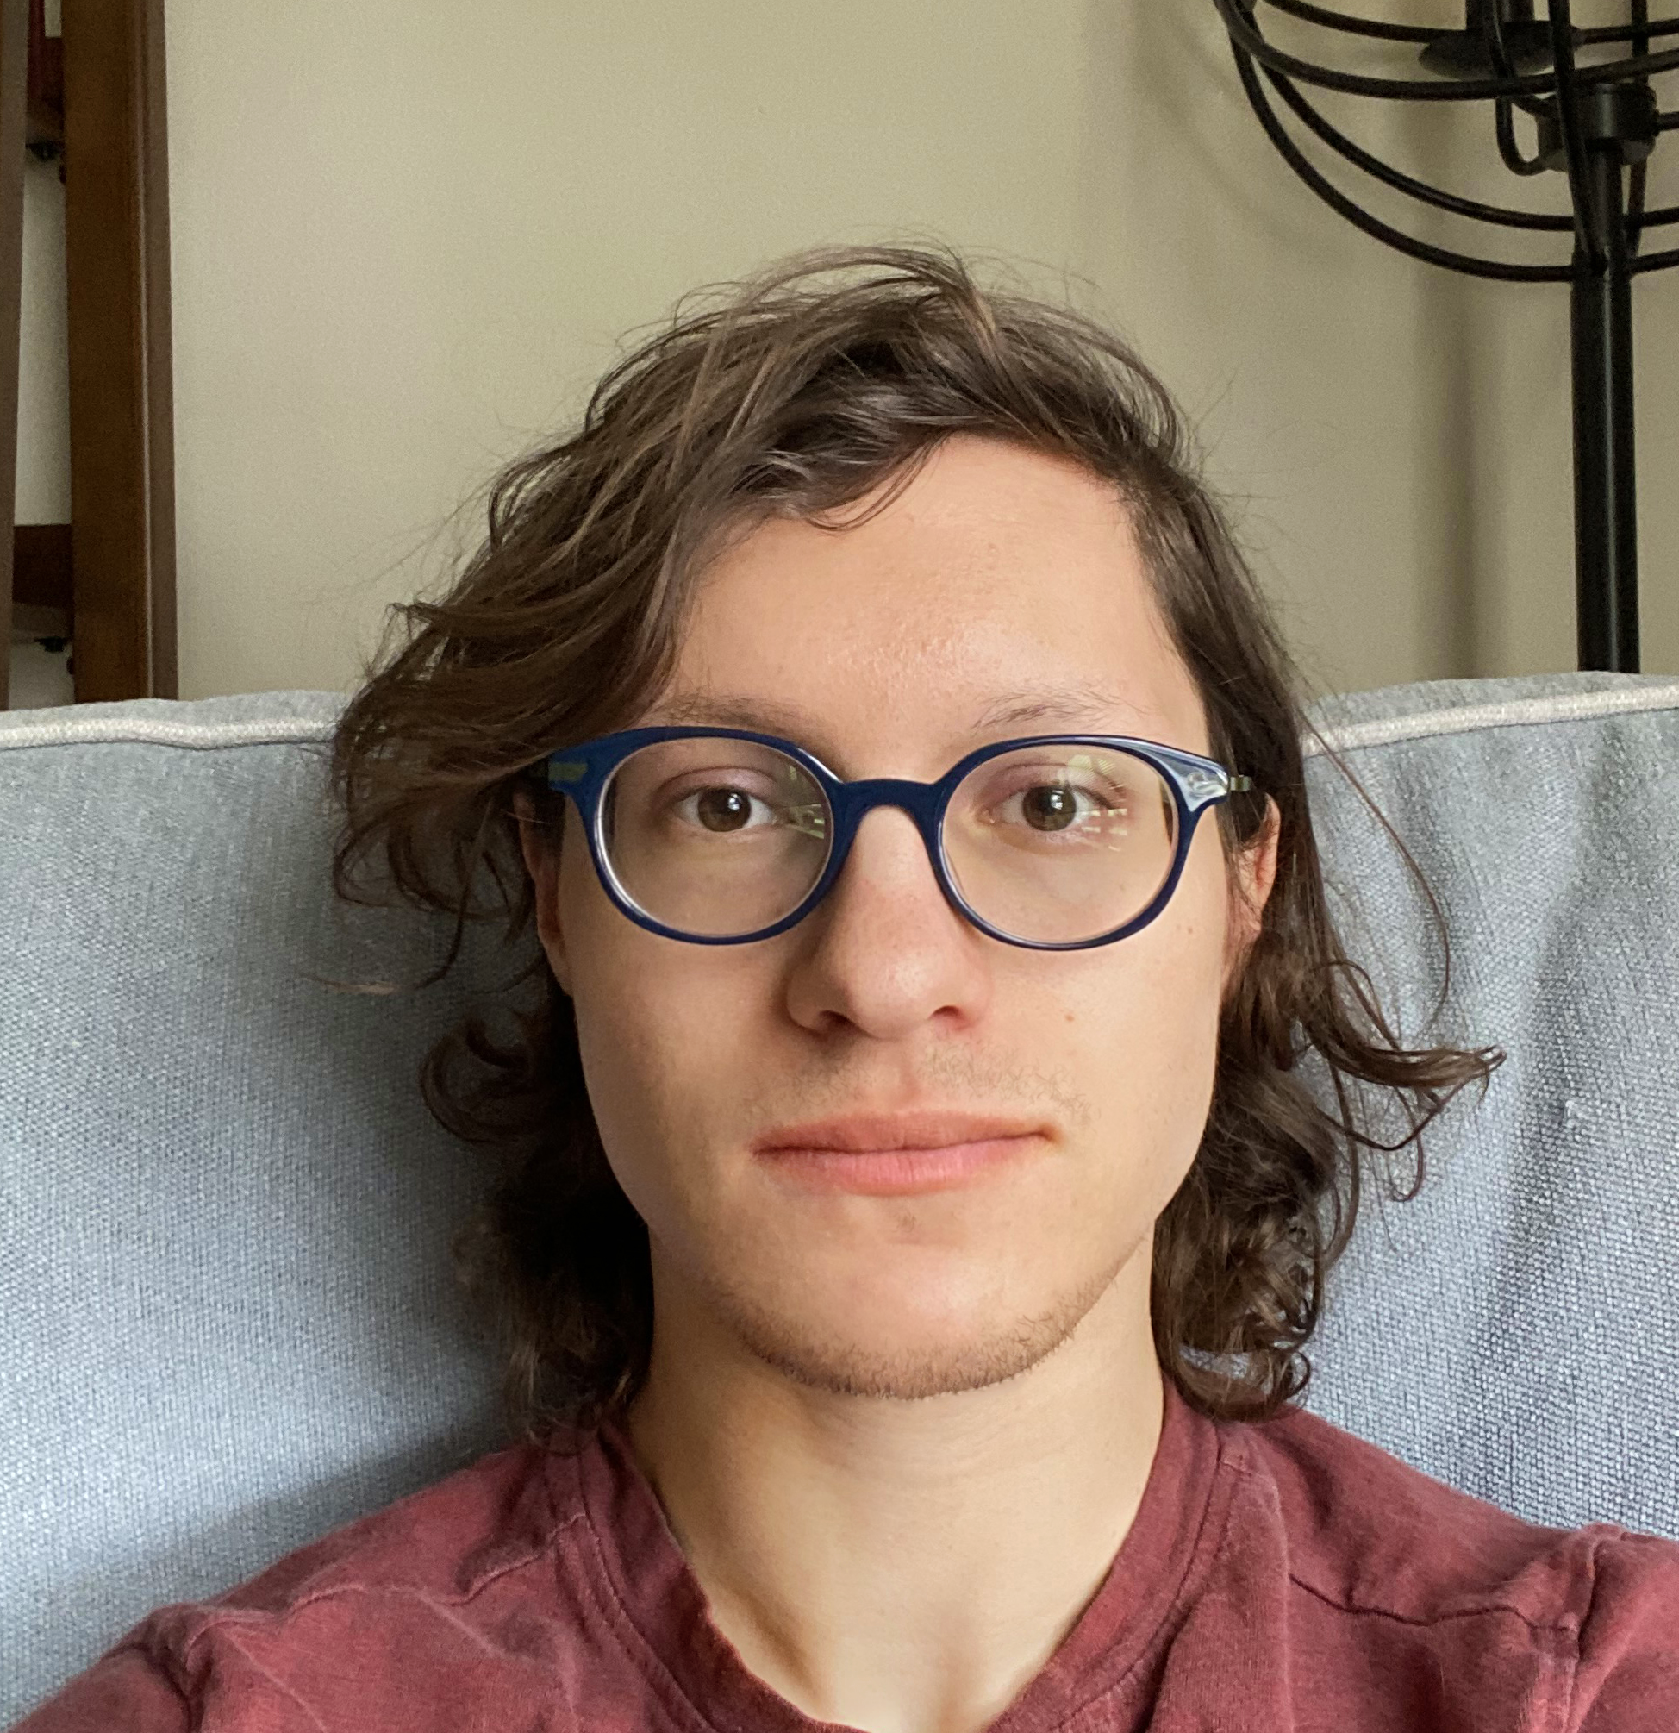
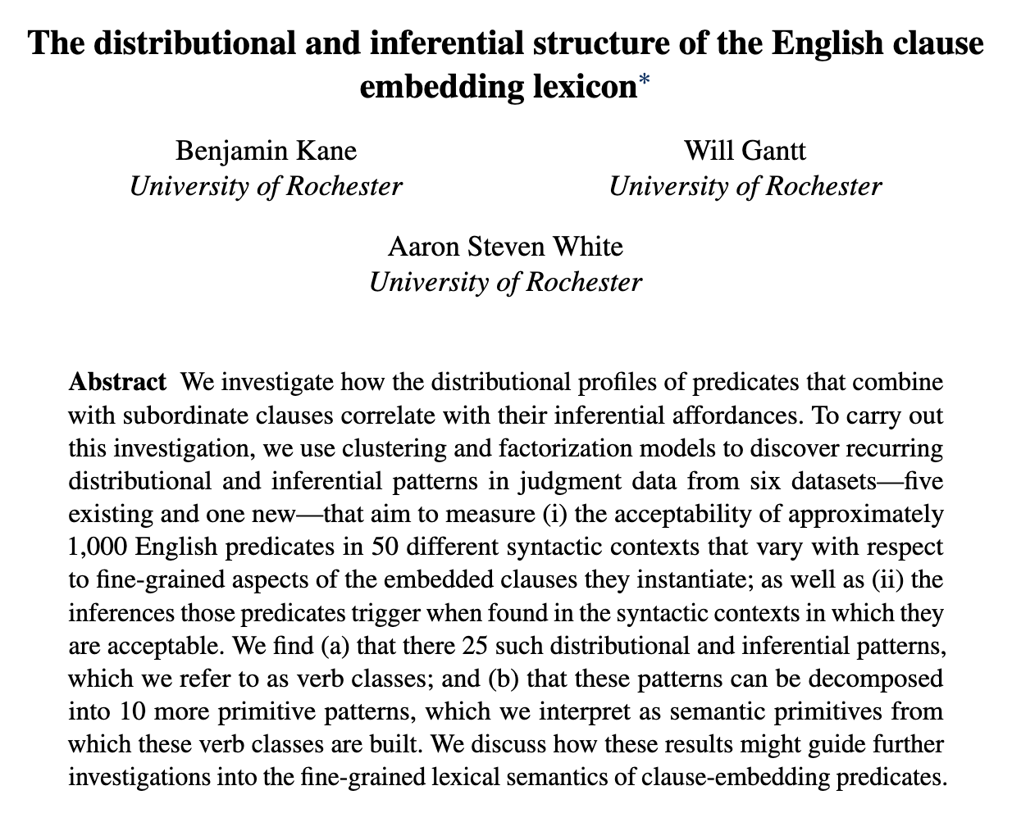
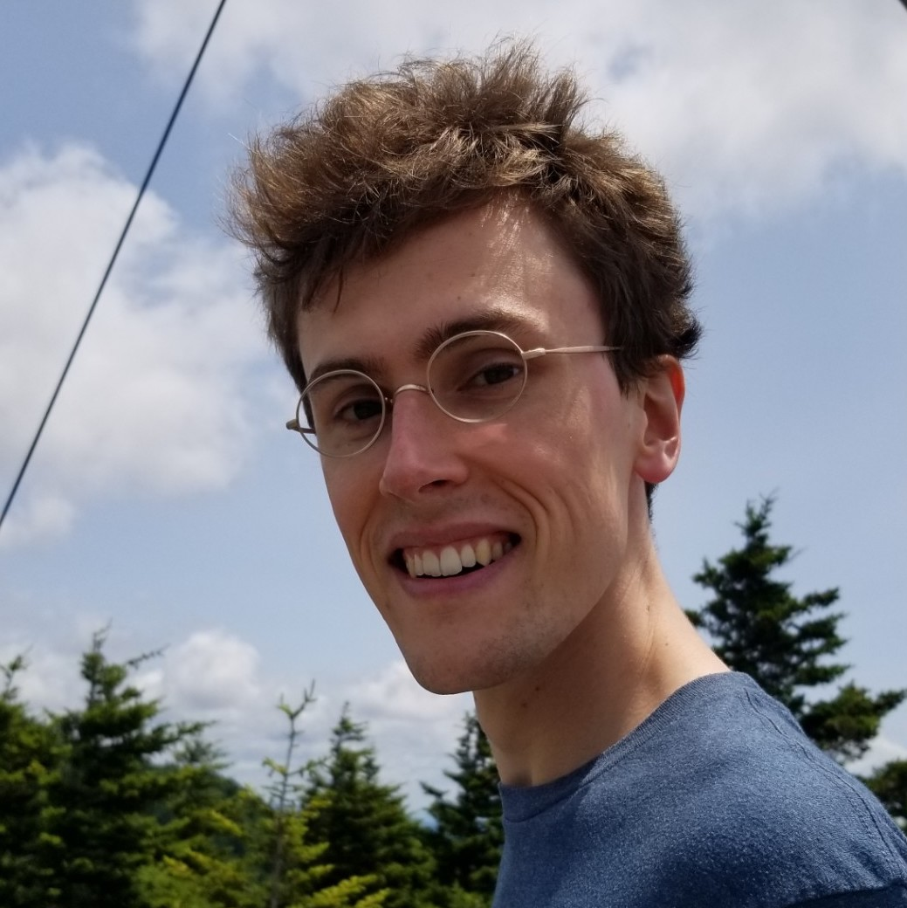
In preparation!
Ben Kane
OpenStream.AI
Will Gantt
Johns Hopkins University

Slide 85
Question
Are any of the induced classes associated with factive inferences (whether they are consistent the prior lit or not)?

Slide 86
Data Component #1
Measure of distribution using acceptability judgments.
Data Component #2
Measure of inferences beyond factive inferences.

Slide 87
Semantic Encoding
Measuring Distribution

Slide 88
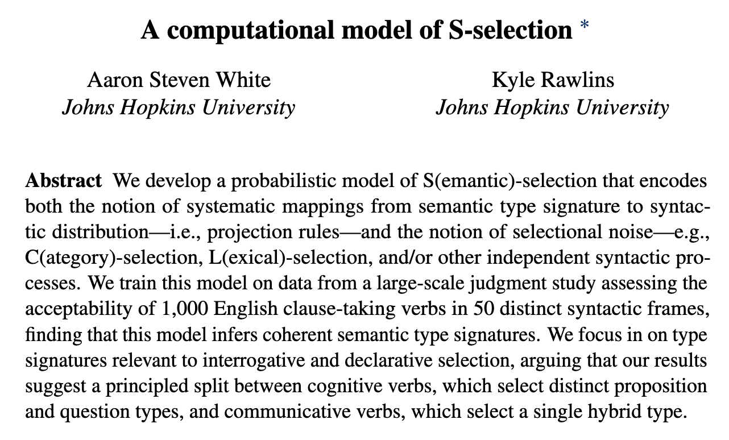
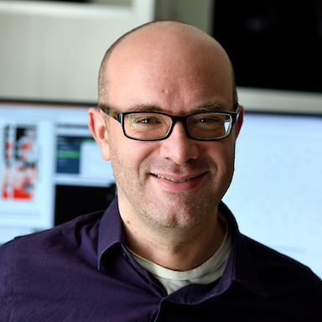
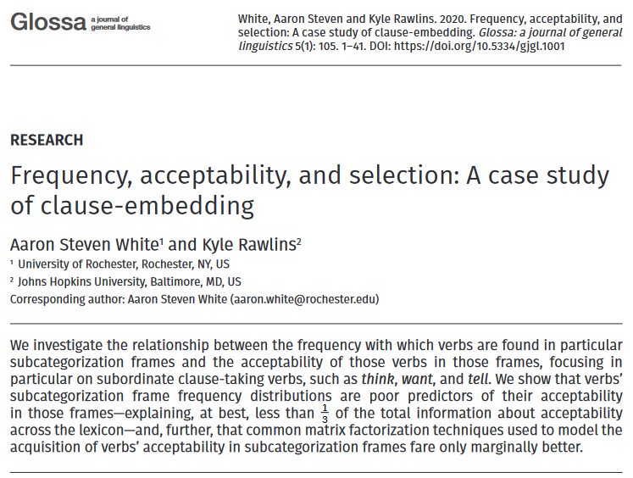
Kyle Rawlins
Johns Hopkins University

Slide 89
MegaAcceptability Dataset
Acceptability for 1,000 verbs in 50 syntactic frames focused on clause-embedding.

Slide 90
Verbs
think
know
wonder
love
surprise
tell
say
start
stop
...

Slide 91
Bleaching Method
Frame templates (e.g. NP __ that S) instantiated by semantically bleached fillers.

Slide 92
Verbs
Frames
think
Someone __ed something happened
know
Someone __ed that something happened
wonder
Someone __ed whether something happened
love
Someone __ed which thing happened
x
surprise
Someone __ed someone that something happened
tell
Someone __ed someone whether something happened
say
Someone __ed to someone that something happened
start
Someone __ed to do something
stop
Someone __ed someone to do something
...
...

Slide 93
MegaAcceptability Dataset
Acceptability for 1,000 verbs in 50 syntactic frames focused on clause-embedding.
50,000 total items x 5 judgments per item

Slide 94
Question
Is bleaching a valid method for capturing the acceptability of a verb in a frame?

Slide 95
Validation Strategy #1 see Appendix D
Compare judgments for bleached items against judgments from trained linguists.
Validation Strategy #2 see Appendix E
Assess generalization drawn from linguist hand-coding of acceptability across many predicates.

Slide 96
Semantic Encoding
Measuring Inference

Slide 97
Recipe
Validate a bleaching paradigm for collecting judgments for an inference type.
Select a set of frames of interest.
Select predicates acceptable in those frames using MegaAcceptability.
Collect judgments using the paradigm.

Slide 98
Veridicality task

Slide 99
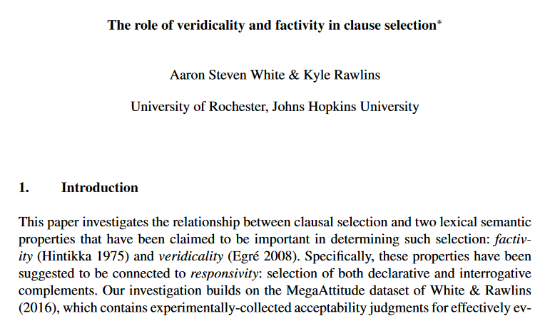
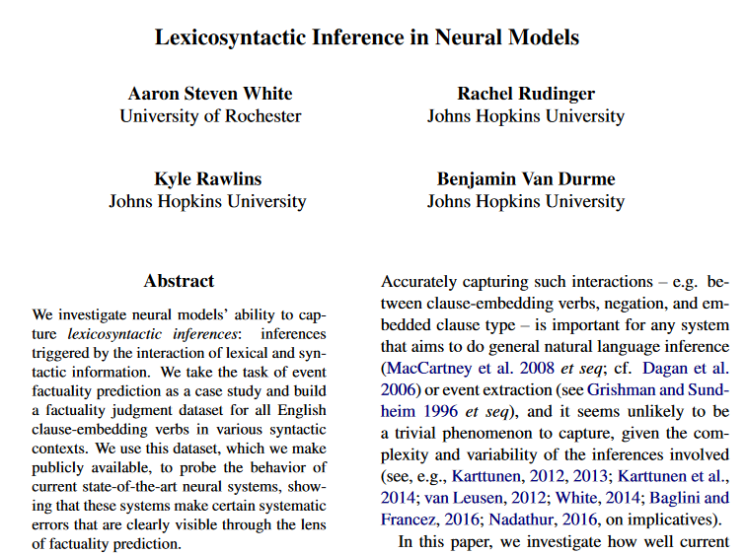
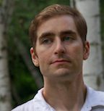
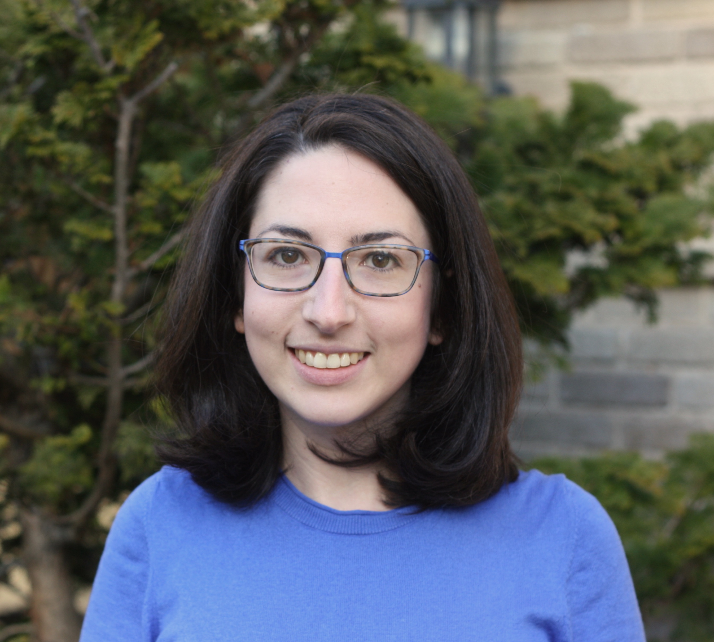
Kyle Rawlins
Johns Hopkins University
Ben Van Durme
Johns Hopkins University
Rachel Rudinger
University of Maryland

Slide 100
Someone was irritated that a particular thing happened.
Veridicality task
Did that thing happen?
no maybe or maybe not yes

Slide 101
NP _ that S
Someone {knew, didn't know} that a particular thing happened.
NP be _ that S
Someone {was, wasn't} surprised that a particular thing happened.
NP _ for NP to VP
Someone {needed, didn’t need} for a particular thing to happen.
NP _ NP to VP[+/-eventive]
Someone {told, didn’t tell} a particular person to do a particular thing.
Someone {believed, didn’t believe} a particular person to have a particular thing.
NP be _ to VP[+/-eventive]
A particular person {was, wasn’t} excited to do a particular thing.
A particular person {was, wasn’t} suspected to have a particular thing.
NP _ to VP[+/-eventive]
A particular person {managed, didn’t manage} to do a particular thing.
A particular person {seemed, didn’t seem} to have a particular thing.

Slide 102
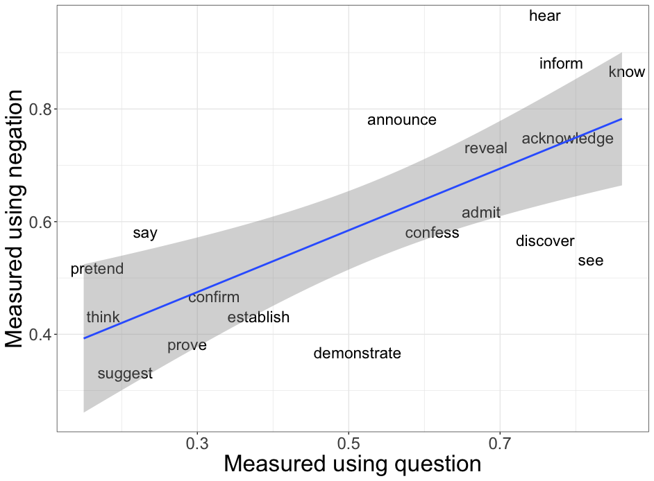
White and Rawlins 2018
r=0.70
Degen and Tonhauser 2018

Slide 103
Belief task

Slide 104
Ben Kane
OpenStream.AI
Will Gantt
Johns Hopkins University

Slide 105
If A knew that C happened, how likely is it that A believed that C happened?
Belief task
Extremely unlikely
Extremely likely

Slide 106
If A persuaded B that C happened, how likely is it that B believed that C happened?
Belief task
Extremely unlikely
Extremely likely

Slide 107
If A was appalled that C happened, how likely is it that A wanted C to have happened?
Desire task
Extremely unlikely
Extremely likely

Slide 108
If A apologized to B that C happened, how likely is it that B wanted C to have happened?
Desire task
Extremely unlikely
Extremely likely

Slide 109
NP _ that S
A {knew, didn't know} that C happened.
NP _ NP that S
A {told, didn't tell} B that C happened.
NP _ to NP that S
A {said, didn't say} to B that C happened.
NP _ that S
A {was, wasn’t} surprised that C happened.
NP _ that S[+future]
A {hoped, didn't hope} that C would happen.
NP _ NP that S[+future]
A {promised, didn't promise} B that C would happen.
NP _ to NP that S[+future]
A {predicted, didn't predict} to B that C would happen.
NP _ that S[+future]
A {was, wasn’t} excited that C would happen.

Slide 110
In preparation!
Ben Kane
OpenStream.AI
Will Gantt
Johns Hopkins University

Slide 111
NP _ for NP to VP
A {wanted, didn’t want} for B to do C.
NP _ to VP[+/-eventive]
A {hoped, didn’t hope} to {do, have} C.
NP _ NP to VP[+/-eventive]
A {told, didn't tell} B to {do, have} C.
NP _ to NP to VP[+/-eventive]
A {said, didn't say} to B to {do, have} C.
NP be _ to VP[+/-eventive]
A {was, wasn’t} believed to {do, have} C.
NP _ NP VP
A {saw, didn’t see} B do C.
NP _ VPing
A {liked, didn’t like} doing C.

Slide 112
If A chose to do C, how likely is it that A intended to do C?
Intention task
Extremely unlikely
Extremely likely

Slide 113
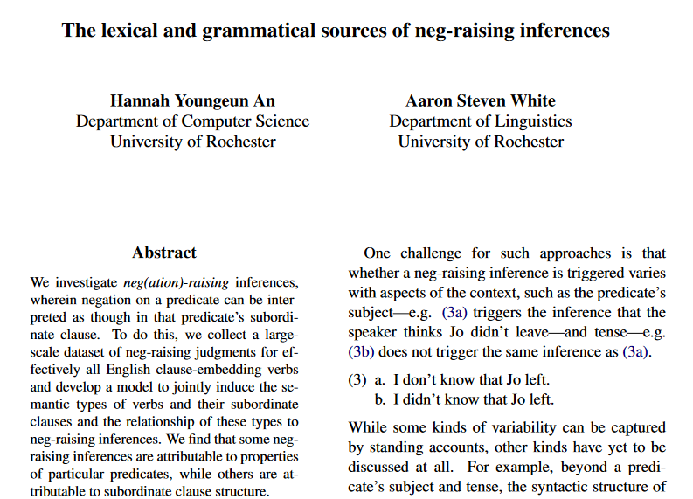
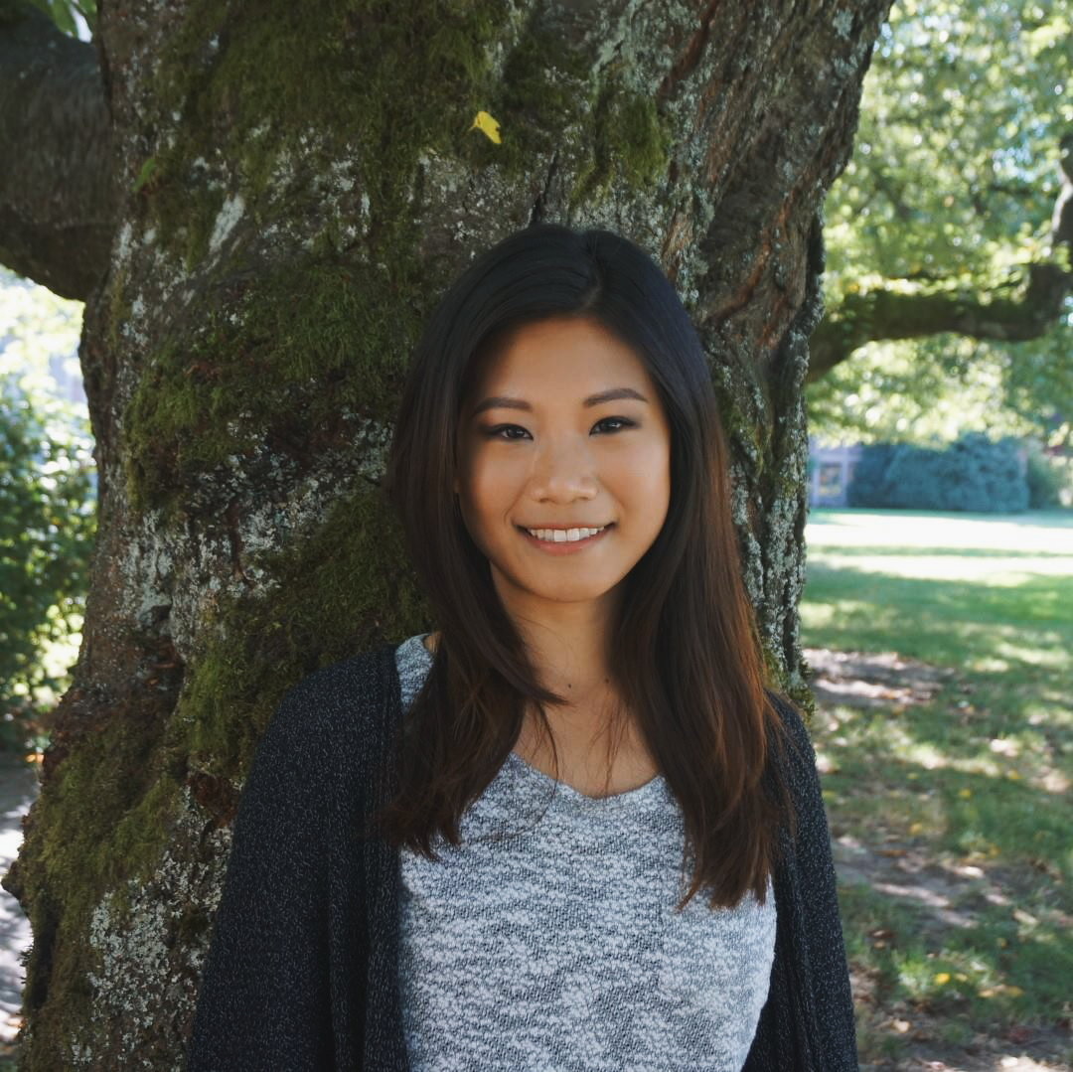
Hannah An
University of Rochester

Slide 114
Neg-raising task

Slide 115
If I were to say I don’t think that a particular thing happened, how likely is it that I mean I think that that thing didn’t happen?
Neg-raising task
Extremely unlikely
Extremely likely

Slide 116
NP _ that S
I {didn’t, don’t}
know that a particular thing happened.
A particular person {didn’t, doesn’t}
NP be _ that S
I {wasn’t, ‘m not}
surprised that a particular thing happened.
A particular person {wasn’t, isn’t}
NP be _ to VP[+/-eventive]
I {wasn’t, ‘m not}
told to do a particular thing.
A particular person {wasn’t, isn’t}
believed to have a particular thing.
NP _ to VP[+/-eventive]
I {didn’t, don’t}
managed to do a particular thing.
A particular person {didn’t, doesn’t}
seemed to have a particular thing.

Slide 117
Question
Is bleaching a valid method for capturing inferences associated with a verb in a frame?

Slide 118
Validation Strategy #1 see Appendix F
Compare judgments for bleached items against judgments from trained linguists.
Validation Strategy #2 see Appendix G
Compare judgments for bleached items to judgments for more contentful items.
Validation Strategy #3 see Appendix H
Compare inference judgments for bleached items to acceptability judgments for distributional diagnostic.

Slide 119
Semantic Encoding
Discovering Patterns

Slide 120
Approach
Cluster predicate-frame pairs in inference space using a multiview mixed effects mixture model.

Slide 121



Inference +
distribution patterns
know
NP _ S
1
2
3
4
5
6
10
11
7
8
9
12
Acceptability
Neg-raising
5
4
1
3
6
Belief
2
7
Desire
Intention
Veridicality
NP[3s] not _ S
NP_ S
NP _ S
NP _ S
NP _ S
0
1
0
1
0
1
0
1
no
maybe
yes

Slide 122



Inference +
distribution patterns
know
NP _ S
1
2
3
4
5
6
10
11
7
8
9
12
Acceptability
Neg-raising
5
4
1
3
6
Belief
2
7
Desire
Intention
Veridicality
NP[3s] not _ S
NP_ S
NP _ S
NP _ S
NP _ S
0
1
0
1
0
1
0
1
no
maybe
yes

Slide 123
All frames simultaneously!!!
Inference +
distribution patterns
know
1
2
3
4
5
6
10
11
7
8
9
12
Acceptability
Neg-raising
5
4
1
3
6
Belief
2
7
5
4
Desire
1
3
6
Intention
Veridicality
2
7
5
4
1
3
6
2
7
5
4
1
3
6
2
7
5
4
1
3
6
2
7
0
1
0
1
0
1
0
1
no
maybe
yes
0
1
0
1
0
1
0
1
no
maybe
yes
0
1
0
1
0
1
0
1
no
maybe
yes
0
1
0
1
0
1
0
1
no
maybe
yes
0
1
0
1
0
1
0
1
no
maybe
yes

Slide 124
Method
Fit model to all data in MegaAcceptability, MegaVeridicality, MegaNegRaising, and MegaIntensionality using MAP estimation.

Slide 125
Output
A distribution over inference + distribution patterns for each verb.

Slide 126
Inference +
distribution patterns
know
1
2
3
4
5
6
10
11
7
8
9
12
Acceptability
Neg-raising
5
4
1
3
6
Belief
2
7
5
4
Desire
1
3
6
Intention
Veridicality
2
7
5
4
1
3
6
2
7
5
4
1
3
6
2
7
5
4
1
3
6
2
7
0
1
0
1
0
1
0
1
no
maybe
yes
0
1
0
1
0
1
0
1
no
maybe
yes
0
1
0
1
0
1
0
1
no
maybe
yes
0
1
0
1
0
1
0
1
no
maybe
yes
0
1
0
1
0
1
0
1
no
maybe
yes

Slide 127
Output
A distribution over inference + distribution patterns for each verb.
For each inference pattern, distributions over judgments for each frame and inference type.

Slide 128
Inference +
distribution patterns
know
1
2
3
4
5
6
10
11
7
8
9
12
Acceptability
Neg-raising
5
4
1
3
6
Belief
2
7
5
4
Desire
1
3
6
Intention
Veridicality
2
7
5
4
1
3
6
2
7
5
4
1
3
6
2
7
5
4
1
3
6
2
7
0
1
0
1
0
1
0
1
no
maybe
yes
0
1
0
1
0
1
0
1
no
maybe
yes
0
1
0
1
0
1
0
1
no
maybe
yes
0
1
0
1
0
1
0
1
no
maybe
yes
0
1
0
1
0
1
0
1
no
maybe
yes

Slide 129
Question
How many inference patterns should we assume exist?
Idea
Only as many as we need to predict judgments for verb-frame-judgment type tuples we have not observed when fitting the model.

Slide 130
Implementation
Select the smallest clustering for which no larger clustering improves prediction of held-out tuples.

Slide 131

Likelihood of held out data
# of inference + distribution patterns

Slide 132
Implementation
Select the smallest clustering for which no larger clustering improves prediction of held-out tuples.
Idea
Optimal number of inference + distribution patterns is 25.

Slide 133
Likelihood of head out data
# of inference + distribution patterns

Slide 134
Interpretation
There are at least 25 distributionally correlated inference patterns.
Important Point #1
Not all inference + distribution patterns instantiated by particular predicates will get their own inference pattern.
Important Point #2
Enriching the distributional representation or range of inferences could increase the granularity of the patterns.

Slide 135
Semantic Encoding
Analyzing Patterns

Slide 136
Question
Do we observe subclasses that consistently give rise to factive inferences?
Reason
Observing such subclasses, which are constrained to explain distribution, is consistent with factivity being semantically represented.

Slide 137
Inference +
distribution patterns
Which predicates have high probability for a pattern?
know
1
2
3
4
5
6
10
11
7
8
9
12
Acceptability
Neg-raising
5
4
1
3
6
Belief
2
7
5
4
Desire
1
3
6
Intention
Veridicality
2
7
5
4
1
3
6
2
7
5
4
1
3
6
2
7
5
4
1
3
6
2
7
0
1
0
1
0
1
0
1
no
maybe
yes
0
1
0
1
0
1
0
1
no
maybe
yes
0
1
0
1
0
1
0
1
no
maybe
yes
0
1
0
1
0
1
0
1
no
maybe
yes
0
1
0
1
0
1
0
1
no
maybe
yes

Slide 138
What is the expected value of each distribution?
Inference +
distribution patterns
know
1
2
3
4
5
6
10
11
7
8
9
12
Acceptability
Neg-raising
5
4
1
3
6
Belief
2
7
5
4
Desire
1
3
6
Intention
Veridicality
2
7
5
4
1
3
6
2
7
5
4
1
3
6
2
7
5
4
1
3
6
2
7
0
1
0
1
0
1
0
1
no
maybe
yes
0
1
0
1
0
1
0
1
no
maybe
yes
0
1
0
1
0
1
0
1
no
maybe
yes
0
1
0
1
0
1
0
1
no
maybe
yes
0
1
0
1
0
1
0
1
no
maybe
yes

Slide 139
Names given by analyst based on manual analysis!
Inference +
distribution patterns
know
1
2
3
4
5
6
10
11
7
8
9
12
Acceptability
Neg-raising
5
4
1
3
6
Belief
2
7
5
4
Desire
1
3
6
Intention
Veridicality
2
7
5
4
1
3
6
2
7
5
4
1
3
6
2
7
5
4
1
3
6
2
7
0
1
0
1
0
1
0
1
no
maybe
yes
0
1
0
1
0
1
0
1
no
maybe
yes
0
1
0
1
0
1
0
1
no
maybe
yes
0
1
0
1
0
1
0
1
no
maybe
yes
0
1
0
1
0
1
0
1
no
maybe
yes

Slide 140

Purely for exposition!
Derived by hierarchical clustering based on expected value of inference distributions.

Slide 141
Plan
Walk through some classes we might expect and show that they look exactly like we would expect them to.

Slide 142
discover, realize, recognize, know, find out, understand, …

Slide 144
discovered
realized
recognized
knew
…
Someone that a particular thing happened.
That thing happened.

Slide 145
discover
realize
recognize
know
…
Someone didn’t that a particular thing happened.
That thing happened.

Slide 147


Slide 148
discovered
realized
recognized
knew
…
Someone that something happened.

Slide 149
discovered
realized
recognized
knew
…
*Someone was that something happened.

Slide 150
dream, hope, think, agree, assume, …

Slide 151
dreamed hoped
thought assumed
…
Someone (*was) that something happened.

Slide 152
dream
hope
think assume
…
Someone did(n’t) that a particular thing happened.
x
That thing happened.

Slide 153

discovered
realized
recognized
knew
…
A that C happened.
A believed that C happened.

Slide 154
discover
realize
recognize
know
…
A didn’t that C happened.
x
A believed that C happened.

Slide 155
dreamed
hoped
thought assumed
…
A that C happened.
A believed that C happened.

Slide 156
be contented, be relieved, be amused, be charmed, be pleased, be comforted, …

Slide 157
pleased
relieved
amused
charmed
…
Someone was(n’t) that a particular thing happened.
That thing happened.

Slide 158
pleased
relieved
amused
charmed
…
A was(n’t) that C happened.
A believed that C happened.

Slide 159

pleased
relieved
amused
charmed
…
A was that C happened.
A wanted C to have happened.

Slide 160
pleased
relieved
amused
charmed
…
A wasn’t that C happened.
x
A wanted C to have happened.

Slide 161
Upshot
We observe classes that recapitulate part of the standard classification of clause-embedding predicates.

Slide 162
Interim Discussion

Slide 163
Question
If we develop a model that accounts for measurement noise and the possibility of multiple subclasses, are factive inferences correlated with distribution?
Answer
Yes.

Slide 164
Upshot
This correlation is consistent with the drivers of factive inferences being semantically represented.

Slide 165
Semantic + Contextual
Purely Contextual
Ambiguity
Resolved Uncertainty
Uncertainty across multiple distinct semantic values for an expression that have different preconditions of use.
Uncertainty across possible discrete states of a discourse that is resolved as a matter of integrating an utterance.
Uncertainty about the preconditions of use inherent to a single semantic value for an expression evoked on every use.
Vagueness
Uncertainty across possible discrete states of a discourse that is not resolved as a matter of integrating an utterance.
Unresolved Uncertainty

Slide 166
Important Point #1
The relationship between the semantic drivers and the factive inferences may be indirect.

Slide 167
Cognitive Nonfactives
Cognitive Semifactives
Positive Emotive Factives
thinks
suspects
knows
realized
loves
likes
A believes that B happened.
A believes that B happened.
A believes that B happened.
B happened.
A believes that B happened.
A wants B to have happened.
think
suspect
know
realize
love
like
A doesn’t believes that B happened.
A doesn’t believes that B happened.
A doesn’t believes that B happened.

Slide 168
Positive Emotive Factives
loves
likes
A believes that B happened.
B happened.
A believes that B happened.
A wants B to have happened.
love
like
A doesn’t believes that B happened.

Slide 169
Positive Emotive Factives
loves
likes
A believes that B happened.
Default credence inference?
Heim 1992, Djarv et al. 2018
B happened.
A believes that B happened.
A wants B to have happened.
Still a lexically encoded precondition of use!
love
like
A doesn’t believes that B happened.

Slide 170
Important Point #1
The relationship between the semantic drivers and the factive inferences may be indirect.
Important Point #2
The information the predicate provides may be purely formal–e.g. predicates may select morphemes that themselves drive factive inferences.

Slide 171






Factivity is strongly linked with a variety of morphemes that mediate the relationship between the embedding predicate and the embedded clause!
among others…

Slide 172
Important Point #3
Purely contextual account may still be possible, but it should explain why the distributional correlations exists.
see Roberts and Simons 2024
Important Point #4
As always, we still need a pragmatic story for how we determine what linguistic expression is being used.

Slide 173
Conclusion

Slide 174
Big Question
What kinds of things do we know when we know the meaning (broadly construed) of a linguistic expression?

Slide 175
One Kind of Knowledge
How the expression can move a conversation forward when used in a particular way.
???
Another Kind of Knowledge
How the conversation has to look for it to even make sense to use the expression.

Slide 176
This Talk
Expressions carry information about preconditions of use in their semantics.
Open class items are (at least part of) the locus of this information.

Slide 177
Question
Why would we see predicates semantically (or at least distributionally) encoding their preconditions of use?
Possible Answer
It might be very hard to learn these preconditions otherwise.

Slide 178

Simply tracking the discourse status of the embedded clause content is unlikely to work!

Slide 179
Thanks!

Slide 180

Supported by NSF-BCS-1748969
The MegaAttitude Project: Investigating selection and polysemy at the scale of the lexicon

Slide 181
Appendix A
Posterior distributions

Slide 182

Posterior distribution of mean response

Slide 183
Appendix B
Prompt manipulation

Slide 184
Question #3
Does the prompt encourage participants to “respond more discretely” because the prompt is a polar question?

Slide 186
Question #3
Does the prompt encourage participants to “respond more discretely” because the prompt is a polar question?
Approach
Modify the prompt to query for the level of likelihood or certainty the speaker has.

Slide 188


Slide 192


Slide 193
Appendix C
Content manipulation

Slide 194
Question #4
Do contents biased for high or likelihood cause people to “respond more discretely”?
Approach
Remove the possibility that people can rely on prior beliefs by bleaching the content of the sentence.

Slide 195


Slide 196


Slide 197


Bleached
Templatic

Slide 198


Slide 199
Appendix D
Acceptability Validation #1

Slide 200
Validation data
Select 30 verbs from across Hacquard & Wellwood's (2012) classification
Gather judgments for these verbs in all 50 syntactic frames from:
trained linguists
naïve speakers

Slide 201
Comparison
Correlation between judgments from LI and Sprouse et al.'s (2013) dataset

Slide 202

Correlation
Sprouse Linguistic Inquiry
MegaAcceptability

Slide 203
Appendix E
Acceptability Validation #2

Slide 204
Case Study The vast majority of about-PPs are adjuncts.
Rawlins 2013, 2014

Slide 205
XP₁ V (XP₂) (XP₃) about XP₄
is acceptable
X
XP₁ V (XP₂) (XP₃)
is acceptable

Slide 206


NP _ed about XP
NP _ed

Slide 207

Rawlins 2014

Slide 208

NP _ed about XP
NP _ed

Slide 209

NP _ed about XP
NP _ed

Slide 210

NP _ed about XP
NP _ed

Slide 211

NP _ed about XP
NP _ed

Slide 212

NP _ed about XP
NP _ed

Slide 213

NP _ed about XP
NP _ed

Slide 214

Independence
Proportion violations
Noise variance / acceptability variance

Slide 215
Independence
Proportion violations
Noise variance / acceptability variance

Slide 216

NP (was) _ed about whether S
NP (was) _ed

Slide 217

NP (was) _ed about whether S
NP (was) _ed

Slide 218

NP (was) _ed about whether S
NP (was) _ed

Slide 219

NP (was) _ed about whether S
NP (was) _ed

Slide 220

Proportion violations
Acceptability threshold

Slide 221
Independence
Proportion violations
Noise variance / acceptability variance

Slide 222
Proportion violations
Acceptability threshold

Slide 223
Proportion violations
Acceptability threshold

Slide 224
Appendix F
Inference Validation #1

Slide 225
 | Neg-raising | Non-neg-raising
NP __ that S | think, believe, feel, reckon, figure, guess, suppose, imagine | announce, claim, assert, report, know, realize, notice, find out
NP __ to VP | want, wish, happen, seem, plan, intend, mean, turn out | love, hate, need, continue, try, like, desire, decide

Slide 226


Mean rating of bleached example
Non-neg-raising
Neg-raising

Slide 227
Appendix G
Inference Validation #2

Slide 228
Implementation
For each verb-frame pair in validation set, sample five items from corpus.

Slide 229

Mean rating of bleached example
r = 0.8
(p < 0.001)
Mean rating of corpus example

Slide 230
Appendix E
Inference Validation #3

Slide 231
Implementation
For each verb-frame pair in validation set, collect acceptability of strong NPI (additive either).
Jo didn’t do a particular thing, and…
…I don’t think that Bo did that thing either.
…I think that Bo didn’t do that thing either.

Slide 232

Mean acceptability of strong NPI
r = 0.77
(p < 0.001)
Mean rating of bleached example

Slide 233
Appendix H
Inference Validation #3

Slide 234
Implementation
For each verb-frame pair in validation set, collect acceptability of strong NPI (additive either).
Jo didn’t do a particular thing, and…
…I don’t think that Bo did that thing either.
…I think that Bo didn’t do that thing either.

Slide 235
Mean acceptability of strong NPI
r = 0.77
(p < 0.001)
Mean rating of bleached example

Slide 236
Appendix I
Predicates in each class

Slide 237
glare, grin, strut, talk, beam, frown, scowl, sulk, …

Slide 238
hound, pester, educate, interview, badger, brief, bug, challenge, …

Slide 239
bury, come, function, happen, invite, result, …

Slide 240
inform, remind, tell, advise, alert, ask, email, notify, warn, …

Slide 241
audit, discipline, approach, chastise, compliment, praise, demean, …

Slide 242
be fazed, be clouded, be gladdened, be affronted, be bored, be blessed, chide, …

Slide 243
defend, imitate, portray, address, conceal, depict, describe, detail, …

Slide 244
buy, delete, alter, attempt, insert, operate, cause, …

Slide 245
coerce, enlist, manipulate, allow, assign, bribe, coax, compel, force, …

Slide 246
articulate, communicate, explain, write, …

Slide 247
affirm, confirm, verify, acknowledge, clarify, …

Slide 248
be contented, be relieved, be amused, be charmed, be pleased, be comforted, …

Slide 249
check, investigate, contemplate, evaluate, examine, explore, …

Slide 250
aim, appear, compete, hunger, try, lust, attempt, start, …

Slide 251
expect, authorize, desire, request, allow, approve, …

Slide 252
dream, hope, think, agree, assume, …

Slide 253
discover, realize, recognize, know, find out, understand, …

Slide 254
manage, glean, opt, presuppose, signify, conclude, …

Slide 255
apologize, complain, cry, gloat, growl, sob, weep, …

Slide 256
(be) depress(ed), (be) disappoint(ed), (be) shock(ed), (be) disgust(ed), (be) displease(ed), (be) embarrass(ed), (be) frustrate(ed), (be) surprise(ed), …

Slide 257
confuse, distress, freak out, panic, perplex, puzzle, stump, baffle, …

Slide 258
fret, lie, agonize, bitch, brood, object, quarrel, quibble, whine, …

Slide 259
decline, fail, hate, neglect, refuse, regret, detest, dislike, …

Slide 260
denounce, disallow, face, prohibit, repress, abhor, admonish, …

Slide 261
doubt, question, dispute, fear, neglect, worry, …

Slide 262
Appendix J
Class-frame relationship

Slide 263
Simple past matrix

Slide 264

Simple present matrix

Slide 265
Past progressive matrix

Slide 266
Appendix K
Class-constituent relationship

Slide 267


Slide 268
Appendix L
Class-inference relationships

Slide 274
Appendix M
Class-primitive relationships

Slide 275


Slide 276
Appendix N
Primitive-constituent relationships

